Slide 1
BICS3 endurance
Irina Mahmudjanova
Aaron Talebi
August 2017

Slide 2
Project Charter: BICS3 reliability with PD data study Project Stream: Data Science/Machine Learning
Problem Statement | Goal/Objective/Purpose
Reliably model BICS3 FBC growth rate in terms of an observable set of parameter values. | Perform a deep analysis of the HTPD/RTPD/LTPD test data to define a model of BICS3 FBC growth rate in terms of the values of a subset of the die qual and die sort parameters. Using a machine learning technique, understand the effect of temperature on FBC .
Requirements/Data Sets/Risks | Approach / Techniques
HTPD under DAT6-EXTENDED-MLC RTPD under DAT6-EXTENDED-MLC LTPD under DAT6-EXTENDED-MLC Die sort Parameters in default.ds_bics_t6rn1_sme1_plot | Part1 Retrieve HTPD, RTPD and LTPD tests parameters from DAT6-EXTENDED-MLC die qual by max FBC. Calculate slope of every die using linear model include different cycling and page_type. Combine die qual data and die sort data, cleaning and tuning parameters for model. Model Lasso with CV and Gradient Boosting Machine for every temperature separated with Slope as responds for retrieve most of important predictors. Standardize important elements from every model fit GLM of the important predictors with DS parameters for finding the contribution of every variables. Model prediction and plotting . Part 2 Continue separated study for HTPD/RTPD/LTPD with FBC as responds. LASSO as absolute shrinkage operator with CV. Prediction of slope using LASSO attributes with GLM. Choosing among Models Using the Validation Set approach, Cross-Validation, XGBoost to predict dies future behavior.
Stakeholder/Customer | Outcomes/ Deliverables/Measurement/Metric
Fei Yu Xiaoyu Yang Qing Li Ming Zhang | Indicators to signal potential affected FBC. Prediction model with Important features for FBC. Contribution of important predictors.

Slide 3
Project Charter: BICS3 reliability with PD data study Project Stream: Data Science/Machine Learning
Problem Statement | Goal/Objective/Purpose
Reliability model BICS3 FBC growth rate in terms of an observable set of parameter values. | Perform a deep analysis of the HTPD/RTPD/LTPD test data to define a model of FBC growth rate and dependencies of die sort parameters across the temperature.
Requirements/Data Sets/Risks | Approach / Techniques
HTPD-HTCYC_EP85C_2P55VCC-T1_R85C RTPD-HTCYC_EP25C_2P55VCC-T1_R25C LTPD under DAT6-EXTENDED-MLC 2 Die sort Parameters in default.ds_bics_t6rn1_sme1_plot | Retrieve HTPD, RTPD and LTPD tests parameters from DAT6-EXTENDED-MLC die qual by max FBC. Clean from outlies and retrieve separated tables for all 3 teperatura from DS. Conduct separate study on LT/RT/HT PD data include cycle conditions and level of page with DS paramets. Calculate slope of every die using GLM by different cycling for every temperature separate. Models for HT/RT/PD with slop Stuck 3 dataset with specified temperature as a extra column. Combine die qual data and die sort data, cleaning and tuning parameters for modeling. Machine Learning and Statistical Learning techniques for Feature selection by, LASSO as absolute shrinkage operator with CV, Random Forest and Ensemble Learning with XGBoost and Ranger pluss Lasso. Choosing among Models using Feature Importance selection approach and contributions of the predictors to the Model.
 | Outcomes/ Deliverables/Measurement/Metric
Fei Yu Xiaoyu Yang Qing Li Ming Zhang | Indicators to signal potential affected FBC. Prediction model with Important features for FBC. Contribution of important predictors.

Slide 4
Working with diequal datasets different temperature
Find and cleaning from few invalid data and renaming the columns
HTPD had 2 rows
RTPD had 3 rows
LTPD has 3 row
# of row | lot | wafer | x | y | level | cycling | FBC
152 | CP0938453 | 6 | 28 | 13 | LP | 3000 | 826
3320 | CP0938453 | 6 | 28 | 13 | UP | 3000 | 473
3336 | CP0938453 | 6 | 28 | 13 | MP | 3000 | 1116
370 | CP0938453 | 6 | 28 | 13 | LP | 3000 | 801
6674 | CP0938453 | 6 | 28 | 13 | UP | 3000 | 552
6707 | CP0938453 | 6 | 28 | 13 | MP | 3000 | 1182
370 | CP0938453 | 6 | 28 | 13 | LP | 3000 | 754
6674 | CP0938453 | 6 | 28 | 13 | UP | 3000 | 472
6707 | CP0938453 | 6 | 28 | 13 | MP | 3000 | 1017

Slide 5
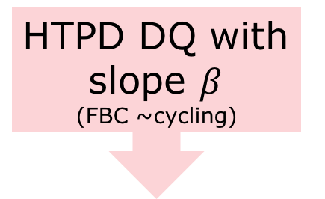
Data preparation and modeling base on slope per die
HTPD DQ with slope $β$
(FBC ~cycling)
Model
LASSO
Variables Extraction
Variables GLM and Contribution
Plotting
cleaning
Merged table HTPD
GBM
Model
Variables Extraction
Variables GLM and Contribution
Plotting
DS
RT
LT

Slide 6
Working with DS parametes
Parameters Tuning | Quantity columns
Eliminating parameters what can not be selected for potential FBC rate. | 1780 | 1737
Eliminating columns with more the 20% missing data | 1737 | 1214
Cleaning all columns close to 0 | 1214 | 811
Eliminate very high correlated features | 813 | 340
Add columns for regression modeling (FBC, Temperature, Cycling, Level) | 350 | 343
For some procedures as XGBoost Level was extended as 3 columns | 1 as 3 | 346

Slide 7
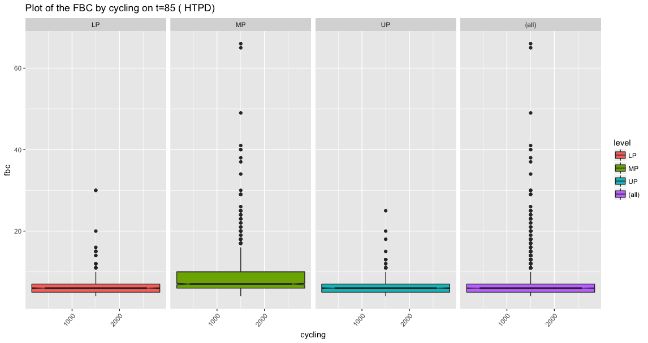

Slide 8
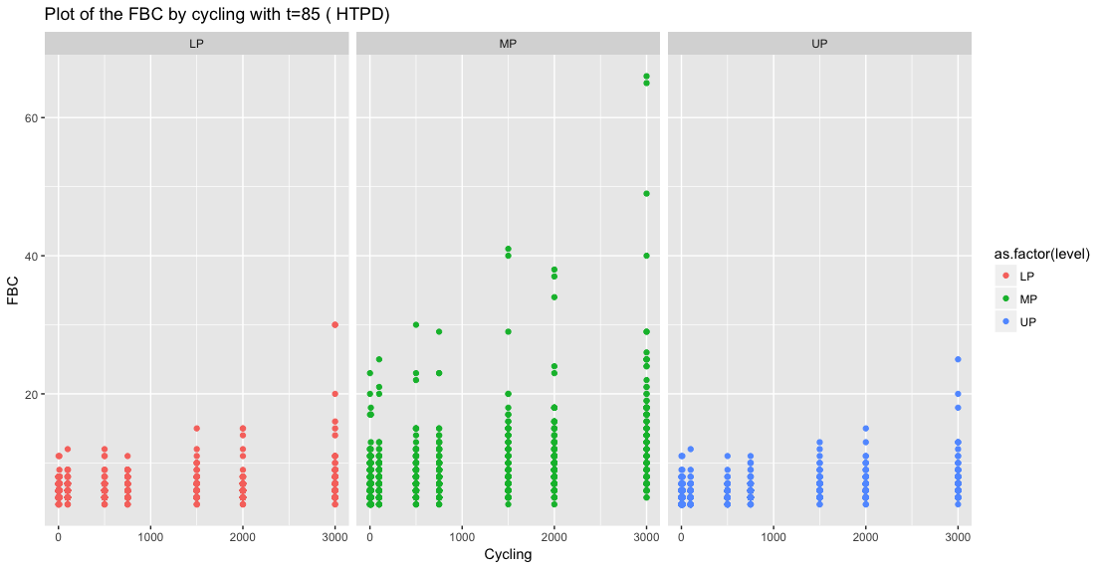

Slide 9
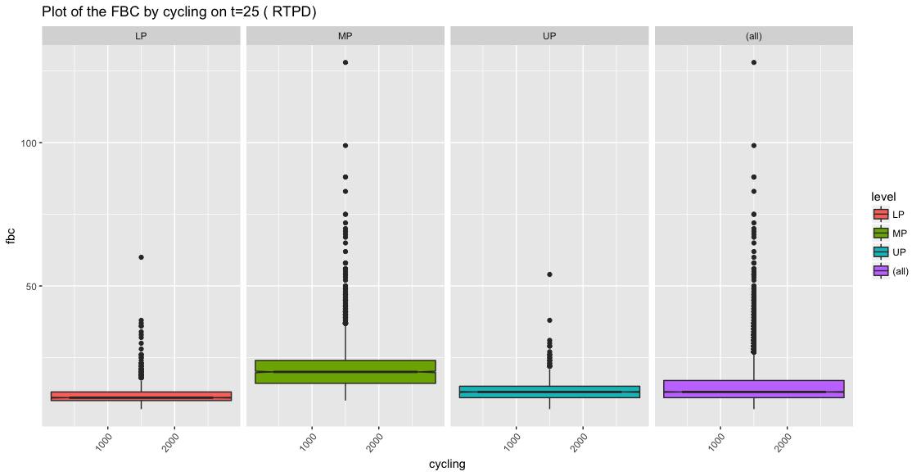

Slide 10
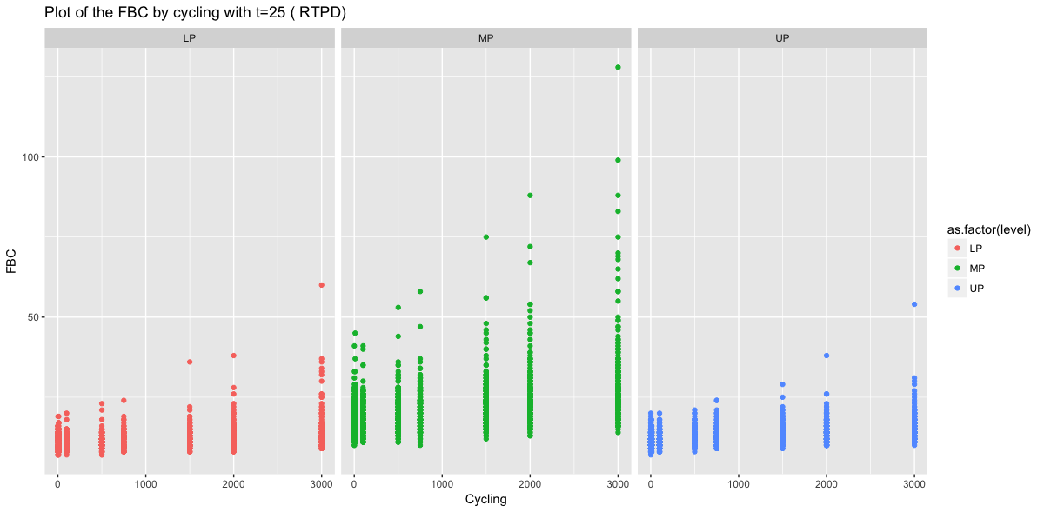

Slide 11
HTPD study with slope
Slop was retrieved from fitting multipule LGLM from FBC~cycling per every die.
Lasso
GBM
ron_no18_t_ua_ | 0.044907754
ron_odt_33_pn_rate_mv_ | 0.001226241
iref_t_ua_ | 0.00037395
crd_scrnslcbot_p_ | 0.000323673
fbc_sdllk0_pcs_ | 0.000270184
vpgmu_bwl_s_dac_ | 0.000231067
fifthratio__ | 0.000225918
vcg_av3_s_dac_ | 0.00017401
bit_mhopen_io3_pcs_ | 0.000119321
sfbc_slcerslp_10kpost_pcs_ | 0.000108414
crd_blleak1_p_ | 0.000103124
frlt_vcgrsft_gr3_pcs_ | 8.95E-05
vpgms_sgdprog_s_dac_ | 6.73E-05
layer4_vpgms_s_dac_ | 6.62E-05
vcgrvstep_s_dac_ | 5.15E-05
bit_mhopen_io4_pcs_ | 3.12E-05
tmps_trim_hts_p_ | 2.38E-05
ron_odt_18p_s_dac_ | 2.27E-05
sfbc_64wls00t1_dc_drpost1_pcs_ | 2.07E-05
vcelsrct_p_ | 1.65E-05
tlcwc_we0_wl0_fr_s25_a2r_pcs_ | 10.25248681
ron_no18_t_ua_ | 9.872344644
vth_sgd_l3s_mv_ | 9.645437565
sfbc_b32wlsaup_drpost_pcs_ | 8.402079877
tpor_us_ | 6.265663978
sfbc_64wls00t1_dc_drpost1_pcs_ | 5.839213944
vth_08pwl60_lt_mv_ | 4.79107911
fbc_sdllk0_pcs_ | 4.649616727
crd_scrnslcbot_p_ | 3.795618968
sfbc_t32wlsaerx_far_fresh_pcs_ | 3.273732284
crd_sdllk_p_ | 3.016071527
sfbc_b32wlsalp_dc_post_pcs_ | 2.439358408
vcg_gr3_t_mv_ | 1.865578758
vpgmulooptrial2__ | 1.522899322
iccs_moni_1_ua_ | 1.198089304
wlds0leak_top_2_pcs_ | 0.886277558
ron_odt_18n_t_ua_ | 0.80437385
vreadt_p_ | 0.791781929
ron_po33_t_ua_ | 0.702768803
wlleak_post_17_na_ | 0.639644584

Slide 12
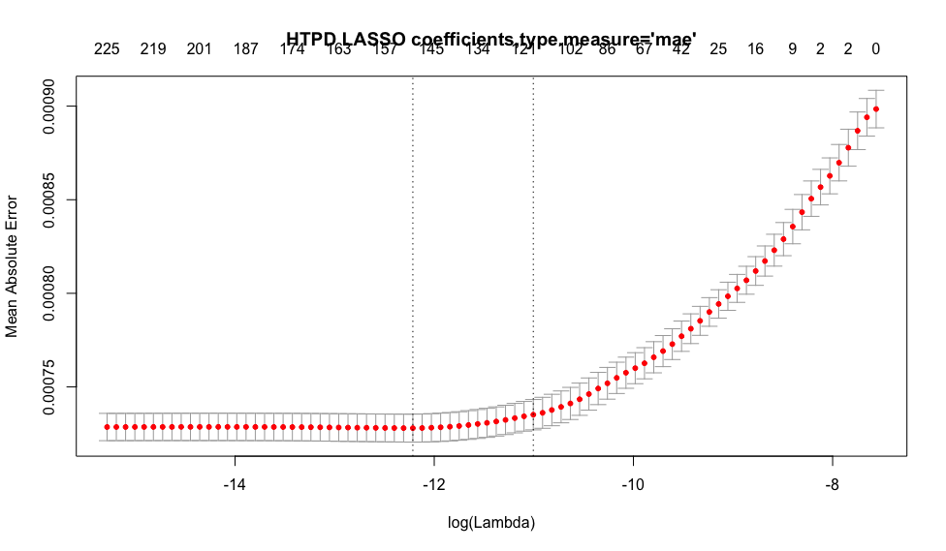
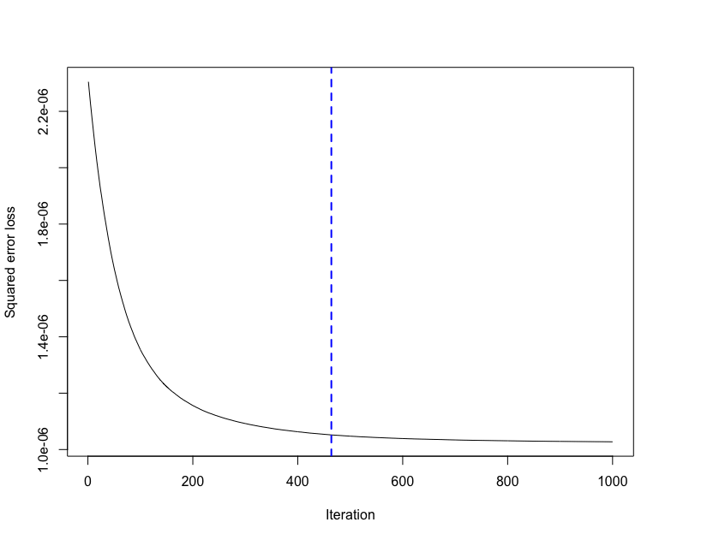
HTPD best iteration GBM 464

Slide 13
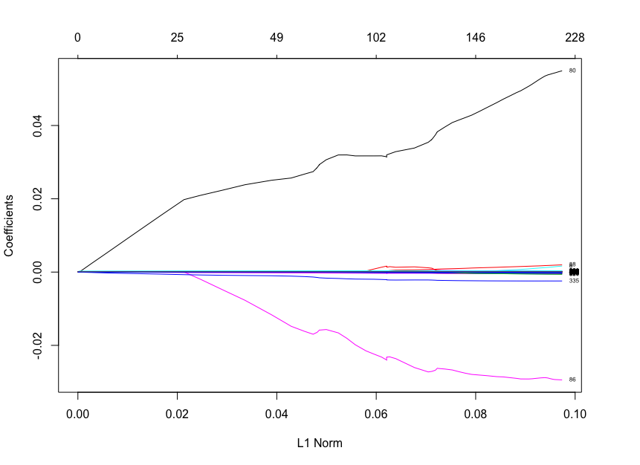
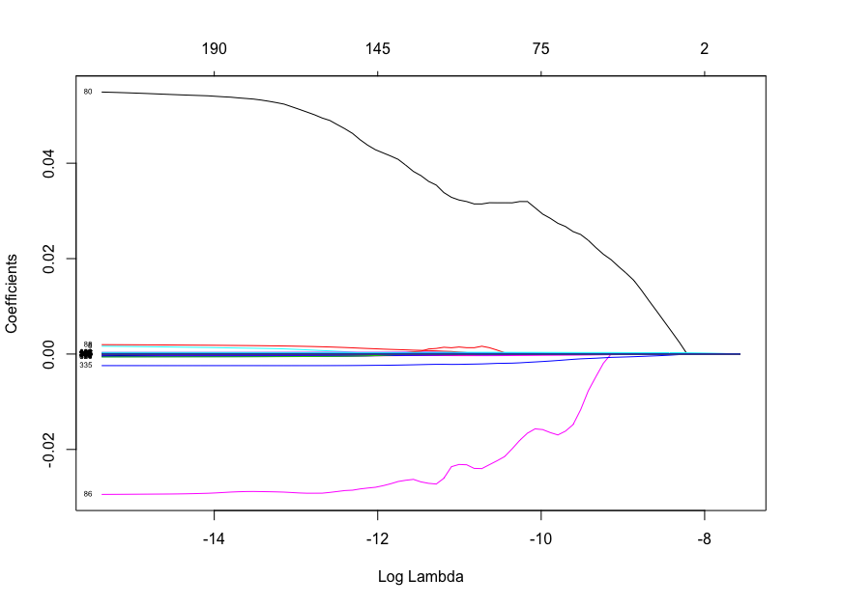
HTPD Lasso coefficients

Slide 14
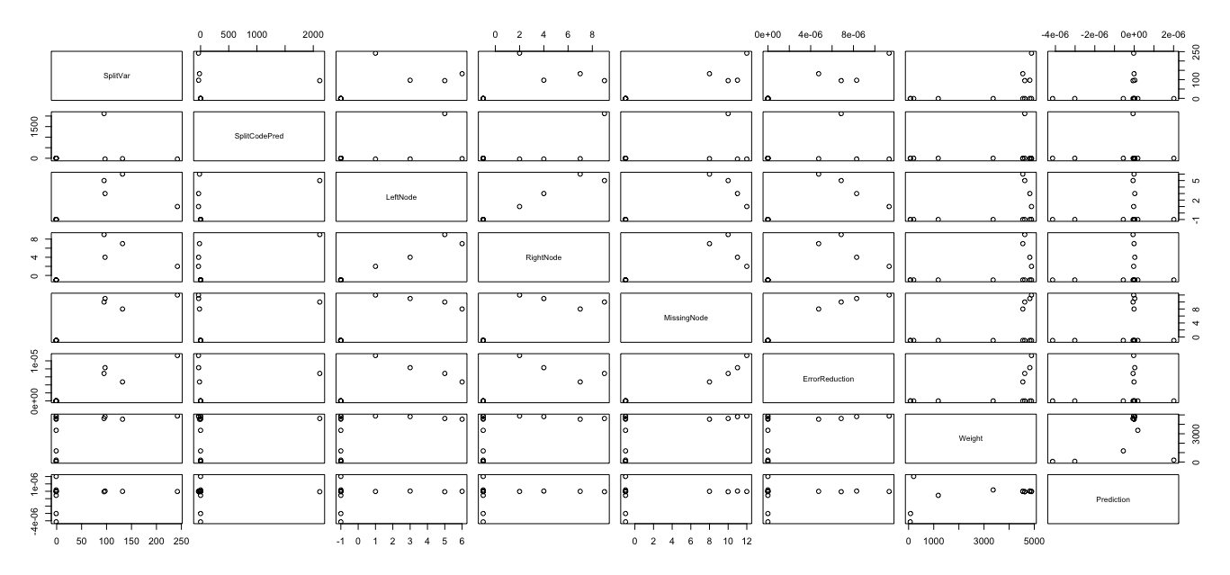

Slide 15
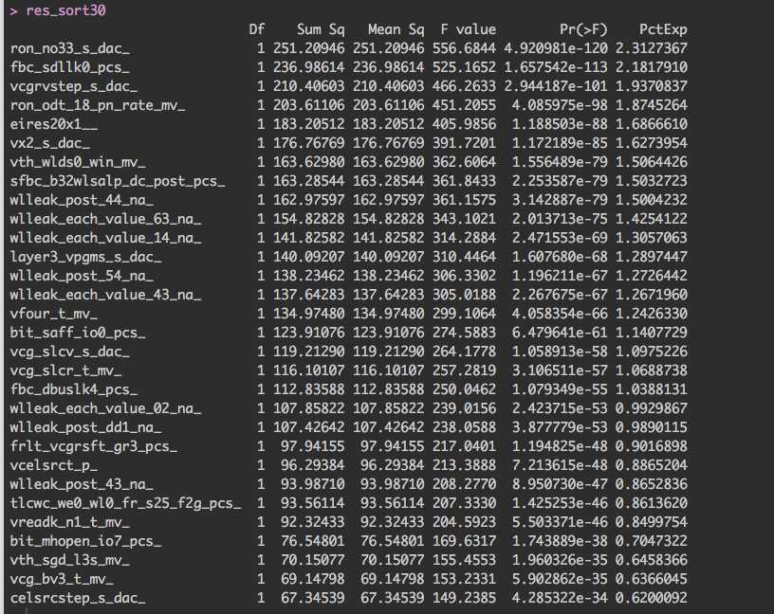
LASSO

Slide 16
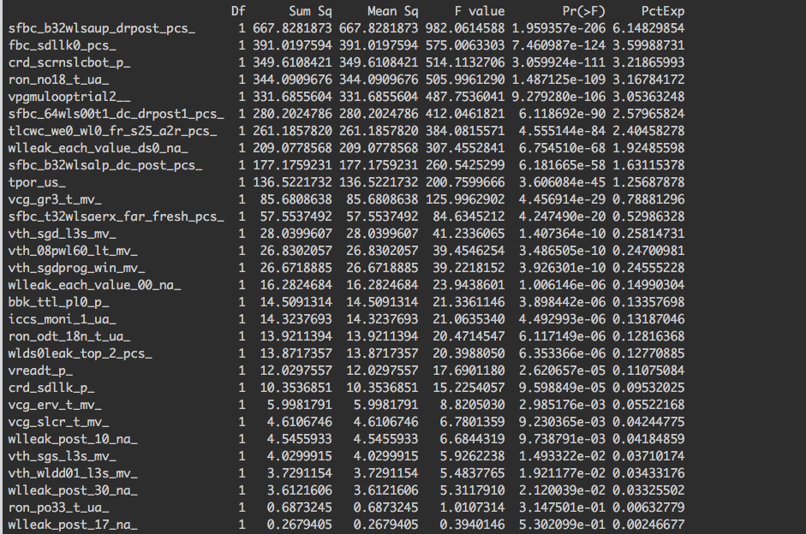
GBM

Slide 17
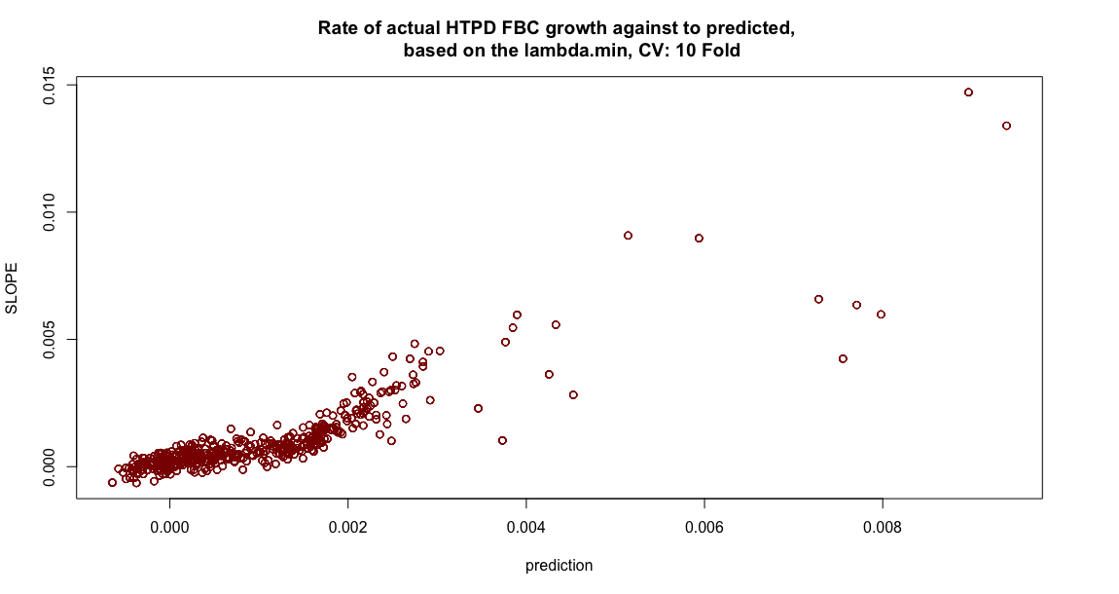

Slide 18
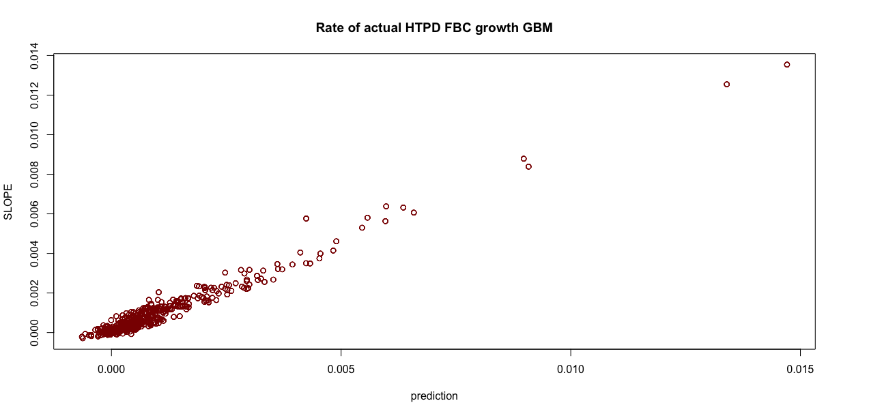

Slide 19
HTPD

Slide 20
RTPD
Lasso
GBM
sgdprog_prog_pass__ | 0.169518026
tpd_ns_ | 0.021694753
ron_odt_18_pn_rate_mv_ | 0.011632874
fifthratio__ | 0.011195238
ron_po33_t_ua_ | 0.008884154
vera_mlc_rate__ | 0.004470982
vdda_s_dac_ | 0.001150976
vpgmu_bwl_s_dac_ | 0.001055998
ersloop_mv_ | 0.00098069
bbk_wlmh_4_d_pcs_ | 0.000916203
vcgrvstep_s_dac_ | 0.000896008
vpass2_s_dac_ | 0.000894599
iref_t_ua_ | 0.000873699
vfour_s_dac_ | 0.000863169
treadm_us_ | 0.000827968
sde_yosc_s_dac_ | 0.000779472
ron_odt_33_pn_rate_mv_ | 0.000725374
tempcode_read_pcs_ | 0.000558965
crd_scrnslcbot_p_ | 0.000555659
frlt_vcgrsft_er3_pcs_ | 0.000515818
vth_08pwl60_lt_mv_ | 23.43529704
crd_scrnslcbot_p_ | 11.38617658
vth_wlds0last_l3s_mv_ | 6.9807955
vpgmulooptrial2__ | 3.966240801
sfbc_b32wlsaup_drpost_pcs_ | 3.701444342
sfbc_b32wlsalp_drpost_pcs_ | 3.439067182
bbk_high_wldd0_ev_d_pcs_ | 3.183152172
bbk_wlds0vth_1_u3_ev_c_pcs_ | 2.67467069
sfbc_t32wlsalp_far_dc_fresh_pcs_ | 1.945491131
vpgm_slc_delta_loop_mv_ | 1.828757077
vpgmslooptrial1__ | 1.739279031
bbk_amhshort1_ev_d_pcs_ | 1.179279211
tlcwc_we0_wl0_fr_s25_a2r_pcs_ | 1.080944658
sfbc_t32wlsalp_far_fresh_pcs_ | 1.072683498
sfbc_t32wlsaerx_far_fresh_pcs_ | 1.0608982
vreadt_p_ | 0.91468646
ron_odt_18n_t_ua_ | 0.789310636
frlt_vcgrsft_gr3_pcs_ | 0.76706032
sfbc_t32wlsalp_drpost_pcs_ | 0.761824779
wlleak_each_value_52_na_ | 0.752493178

Slide 21
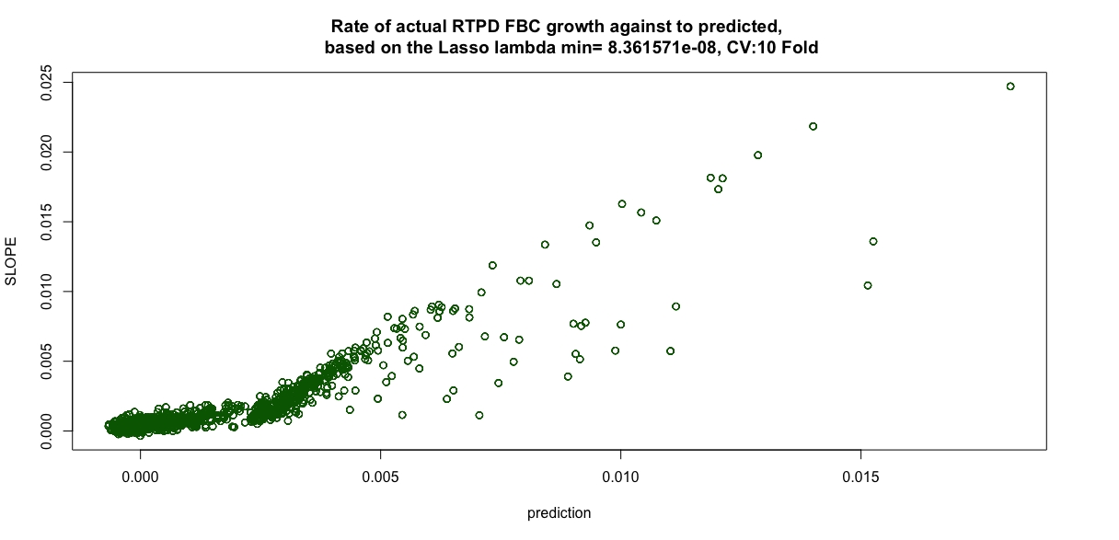

Slide 22
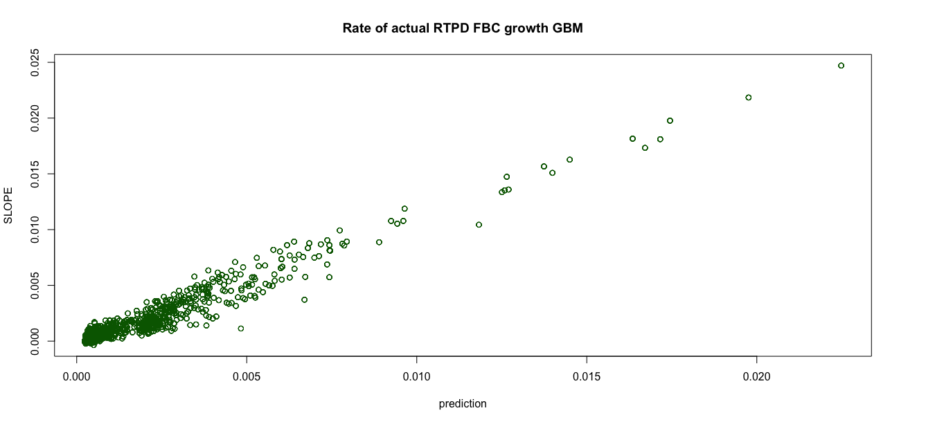

Slide 23
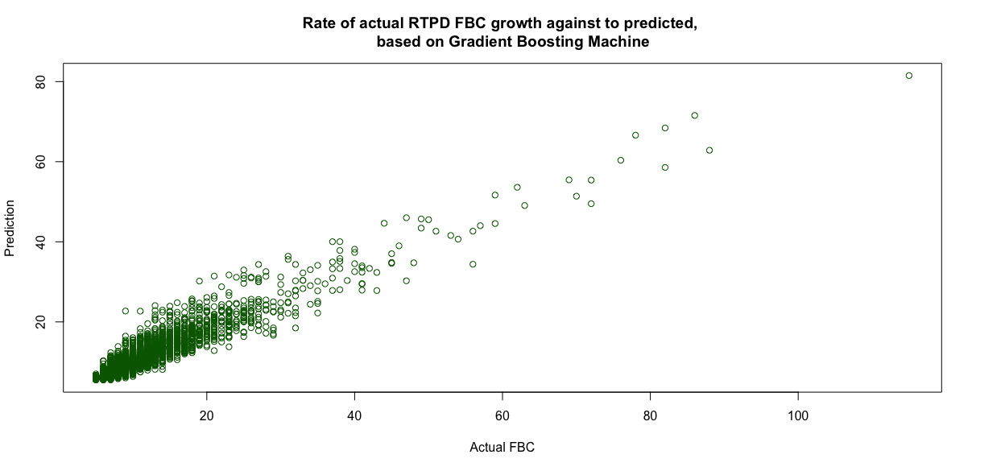

Slide 25
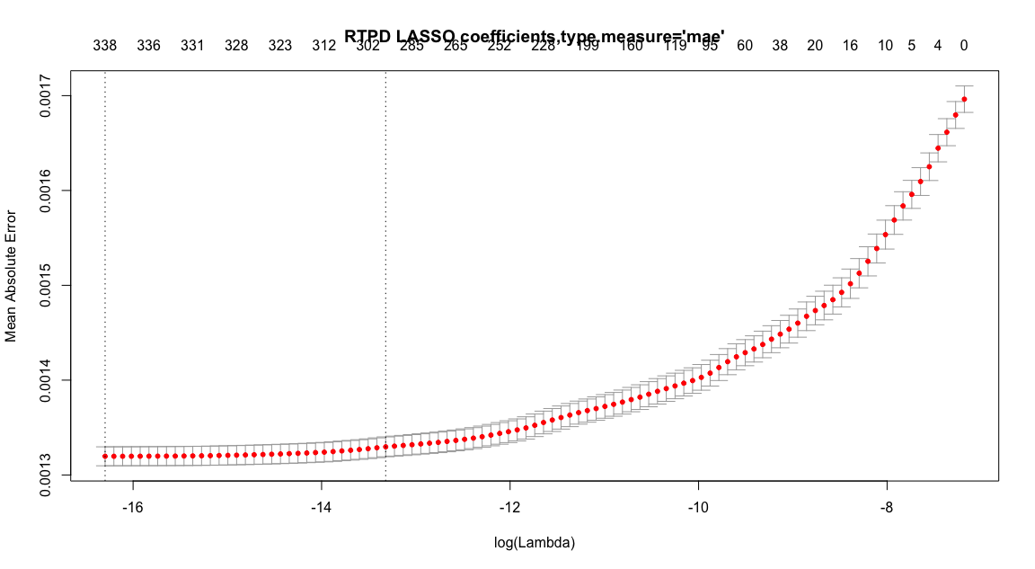
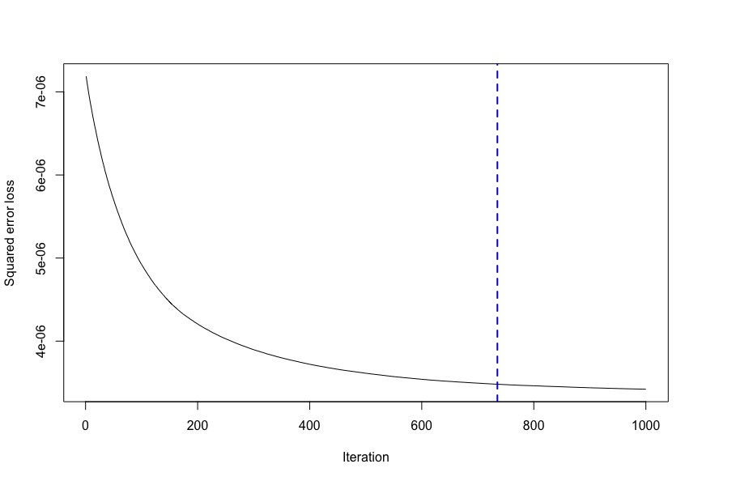
RTPD LASSO GLM and GBMachine
RTPD best iteration in GBM 735

Slide 26
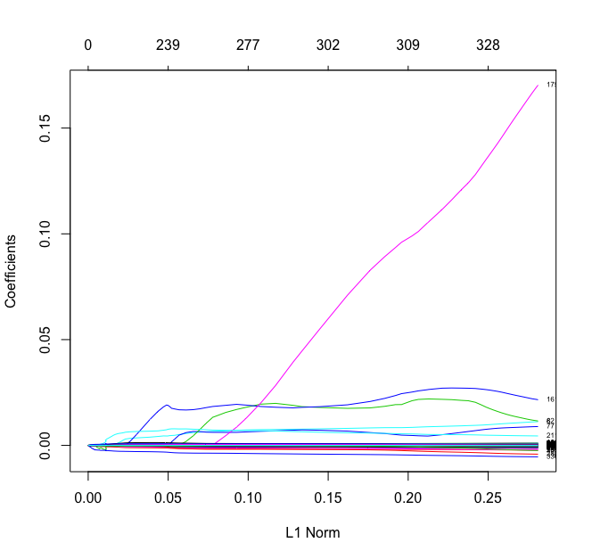
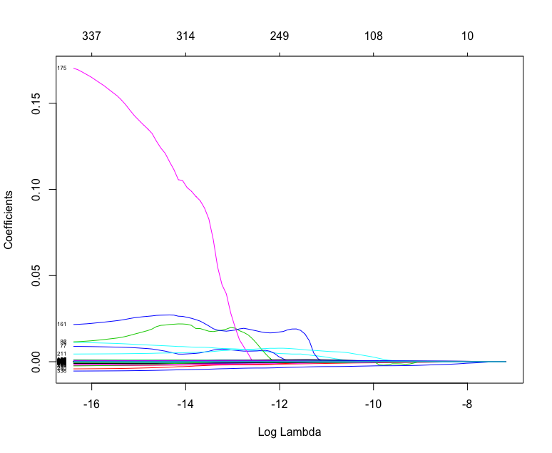

Slide 27
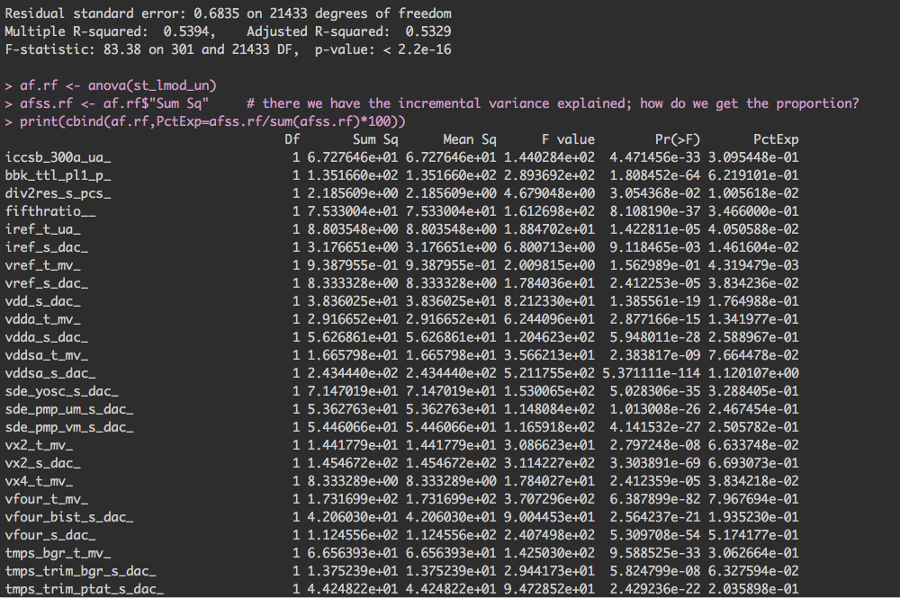
GlmnetLasso important variables contribution RTPD

Slide 28
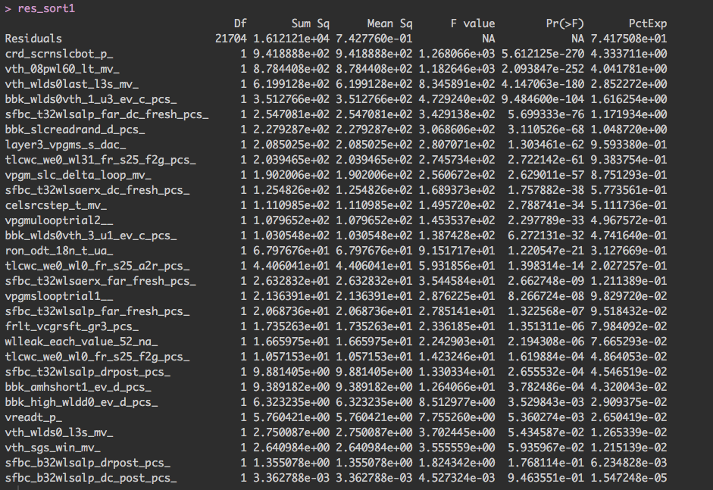
GBMachine important variables contribution RTPD

Slide 30
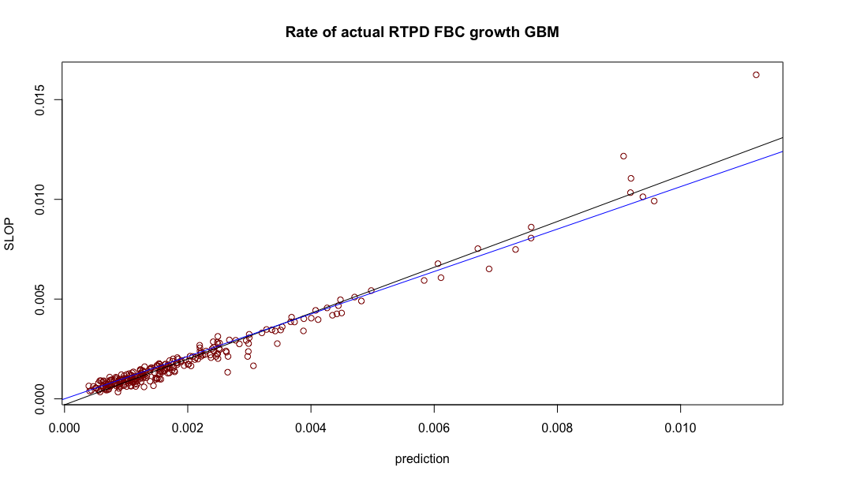

Slide 31
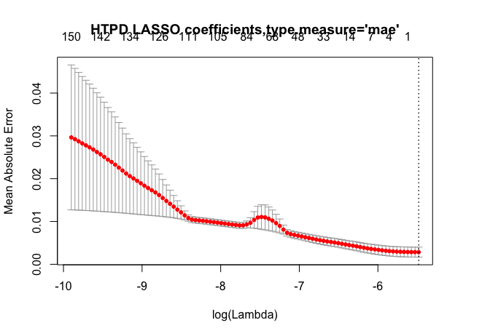
LTPD study with slop
Slop was retrieved from fitting multipule LGLM from FBC~cycling per every die.
Lasso
GBM
name | coefficient
vf_sk_mv_ | 0.002270882
wlleak_post_60_na_ | 16.26614348
iref_t_ua_ | 6.18205421
sfbc_64wls01t0_dc_post_pcs_ | 4.700381766
wlds0leak_bot_1_pcs_ | 4.637431638
tlcwc_we0_wl63_fr_s25_f2g_pcs_ | 3.129235382
wlleak_post_20_na_ | 2.996816316
vpass3_t_mv_ | 2.884527531
vpgms_sgdprog_t_mv_ | 2.598702892
wlleak_post_39_na_ | 2.578763225
wlleak_post_57_na_ | 2.401830257
veramaxt_p_ | 2.255742986
wlleak_each_value_06_na_ | 2.194481372

Slide 32
Lasso variables LTPD
LTPD GBM variables importance
sgdprog_prog_pass__ | 0.227936495
ron_odt_18_pn_rate_mv_ | 0.033022236
ron_po33_t_ua_ | 0.01748188
vera_mlc_rate__ | 0.004269249
ron_odt_33_pn_rate_mv_ | 0.004027264
fifthratio__ | 0.001343225
ersloop_mv_ | 0.001118038
iref_t_ua_ | 0.001082431
crd_scrnslcbot_p_ | 0.000969297
vfour_s_dac_ | 0.00086794
sde_yosc_s_dac_ | 0.0007937
vpass2_s_dac_ | 0.000681947
vpgmu_bwl_s_dac_ | 0.000663358
vcgrvstep_s_dac_ | 0.00064345
sgdprog_erase_pass__ | 0.000530437
bbk_amhshort1_ev_d_pcs_ | 0.000524226
bbk_wlmh_6_d_pcs_ | 0.000501403
treadm_us_ | 0.000495321
vpass1_s_dac_ | 0.000409472
crd_adl1_1vdd_p_ | 0.000380668
crd_scrnslcbot_p_ | 22.69136111
vth_08pwl60_lt_mv_ | 19.59551612
sfbc_b32wlsaup_drpost_pcs_ | 3.856702963
vth_wlds0last_l3s_mv_ | 3.605027722
vpgmslooptrial1__ | 3.501923154
frlt_vcgrsft_gr3_pcs_ | 2.513096916
tlcwc_we0_wl31_fr_s25_f2g_pcs_ | 2.365224148
sfbc_t32wlsaerx_far_fresh_pcs_ | 2.227986839
bbk_high_wldd0_ev_d_pcs_ | 2.169666743
vpgm_slc_delta_loop_mv_ | 2.130653739
prgloop_wl00_mv_ | 1.98020111
sfbc_t32wlsalp_far_dc_fresh_pcs_ | 1.902534425
vth_wlds0_l3s_mv_ | 1.710863905
sfbc_b32wlsalp_drpost_pcs_ | 1.633115657
bbk_wlds0vth_3_u1_ev_c_pcs_ | 1.328016497
bbk_wlds0vth_1_u3_ev_c_pcs_ | 1.095335974
vcelsrct_p_ | 0.900586809
sfbc_64wls01t0_dc_post_pcs_ | 0.824501128
vreadt_p_ | 0.792787781
wlleak_each_value_ds0_na_ | 0.77013992

Slide 33
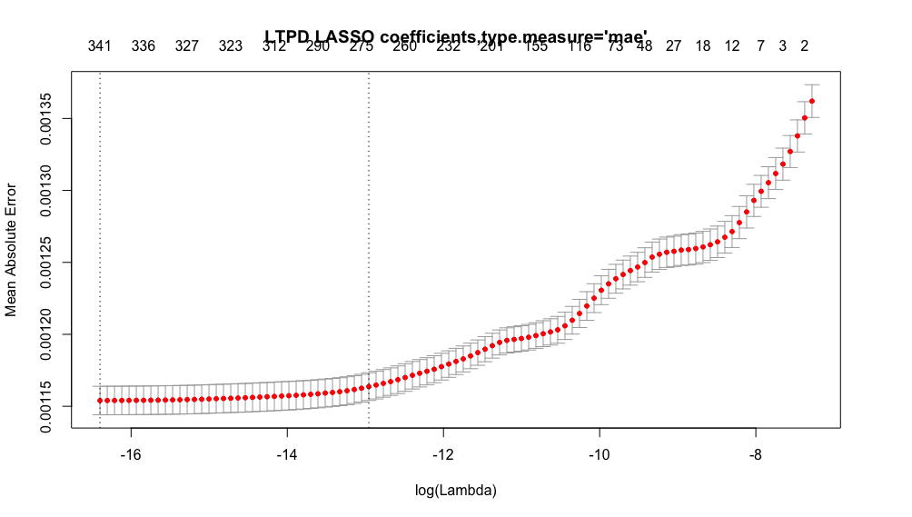
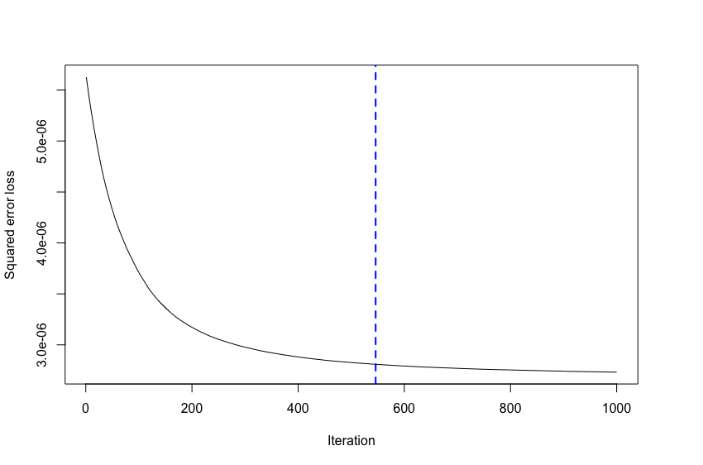
LTPD GBM best iteration 546

Slide 34
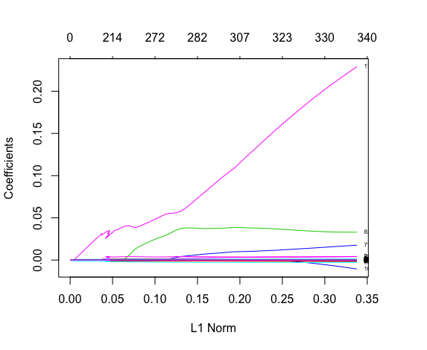
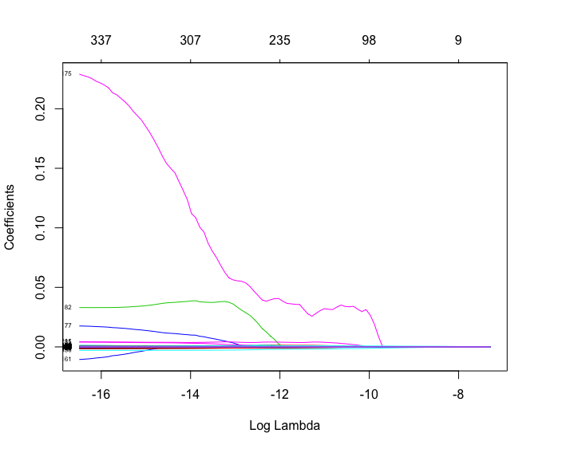

Slide 35
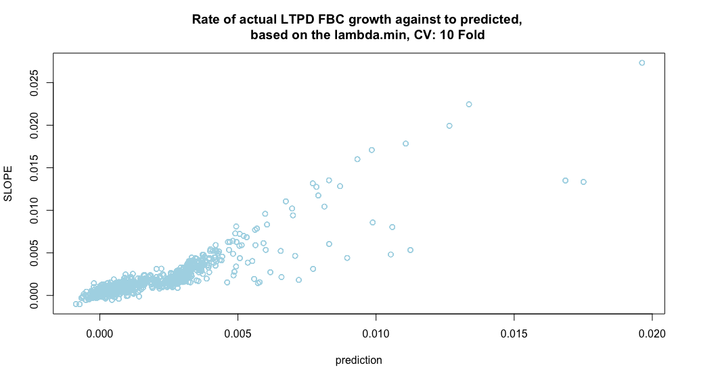

Slide 36
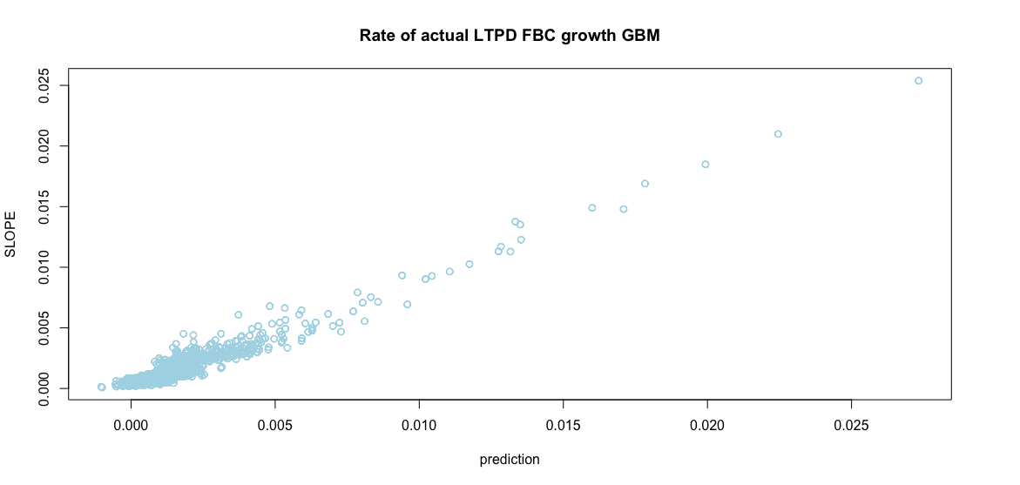

Slide 38
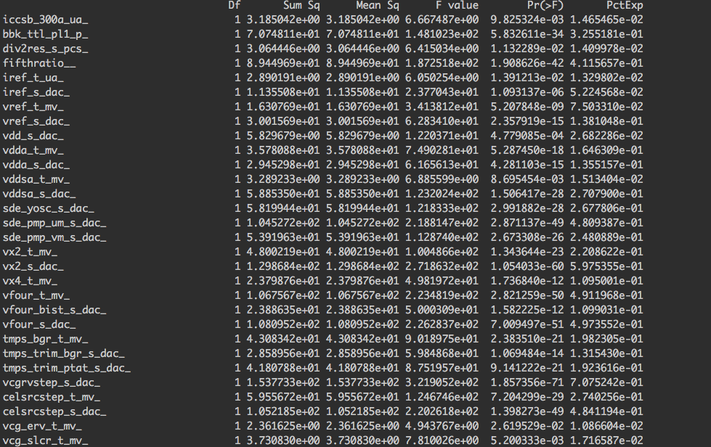
LASSO contributions

Slide 39
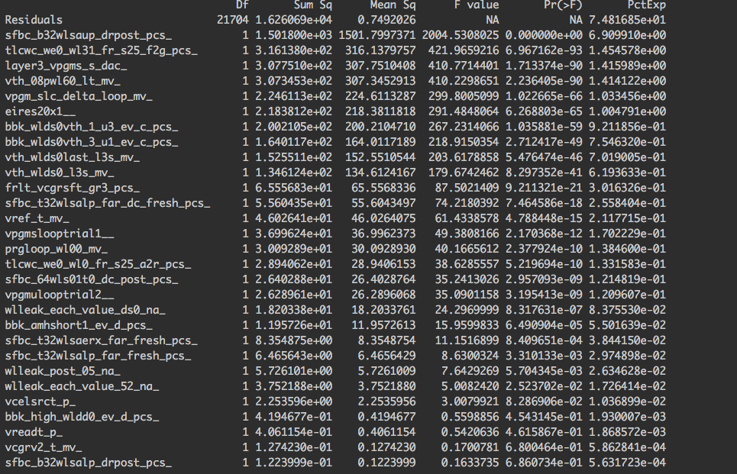
GBM

Slide 40
Continue separated study used FBC as responds
HTPD
Lasso
GBM
Retrieving Variables Impotence
Contribution and prediction plotting
RTPD
Lasso
GBM
Retrieving Variables Impotence
Contribution and prediction plotting
LTPD
Lasso
GBM
Retrieving Variables Impotence
Contribution and prediction plotting

Slide 41
HTPD Lasso Variables coefficients
HTPD GBM variables importance
ron_no18_t_ua_ | 51.35775159
ron_odt_33_pn_rate_mv_ | 3.523531435
levelMP | 2.546980724
fifthratio__ | 2.182874799
iref_t_ua_ | 1.107910459
crd_scrnslcbot_p_ | 0.487788979
ron_odt_18p_s_dac_ | 0.406851659
fbc_sdllk0_pcs_ | 0.278488843
vcgrvstep_s_dac_ | 0.273593639
tempcode_read_pcs_ | 0.253481241
vpgmu_bwl_s_dac_ | 0.248723215
vfour_s_dac_ | 0.19329192
vfour_bist_s_dac_ | 0.162113092
bbk_wlmh_4_d_pcs_ | 0.15640313
frlt_vcgrsft_er3_pcs_ | 0.15195865
frlt_vcgrsft_gr3_pcs_ | 0.132025827
bit_saff_io0_pcs_ | 0.113724033
vdd_s_dac_ | 0.112846922
vcg_av3_s_dac_ | 0.106656062
layer4_vpgms_s_dac_ | 0.068388636
level | 19.71038476
cycling | 15.52538513
sfbc_b32wlsaup_drpost_pcs_ | 9.506458548
vth_08pwl60_lt_mv_ | 4.678707498
ron_no18_t_ua_ | 3.831984312
sfbc_t32wlsaerx_far_fresh_pcs_ | 3.699793748
tlcwc_we0_wl0_fr_s25_a2r_pcs_ | 3.476240762
vth_sgd_l3s_mv_ | 3.109317169
sfbc_b32wlsalp_dc_post_pcs_ | 2.048264763
tlcwc_we0_wl0_fr_s25_f2g_pcs_ | 1.744640411
sfbc_t32wlsalp_far_dc_fresh_pcs_ | 1.471965889
vreadt_p_ | 1.217974154
vth_sgs_l3s_mv_ | 1.20876936
sfbc_64wls00t1_dc_drpost1_pcs_ | 1.084427725
tpor_us_ | 1.082504277
frlt_vcgrsft_ar3_pcs_ | 0.927753463
sde_s_dac_ | 0.905064456
vpgmulooptrial2__ | 0.850203863
vreadk_n1_t_mv_ | 0.829787771
veramaxt_p_ | 0.781699837

Slide 42
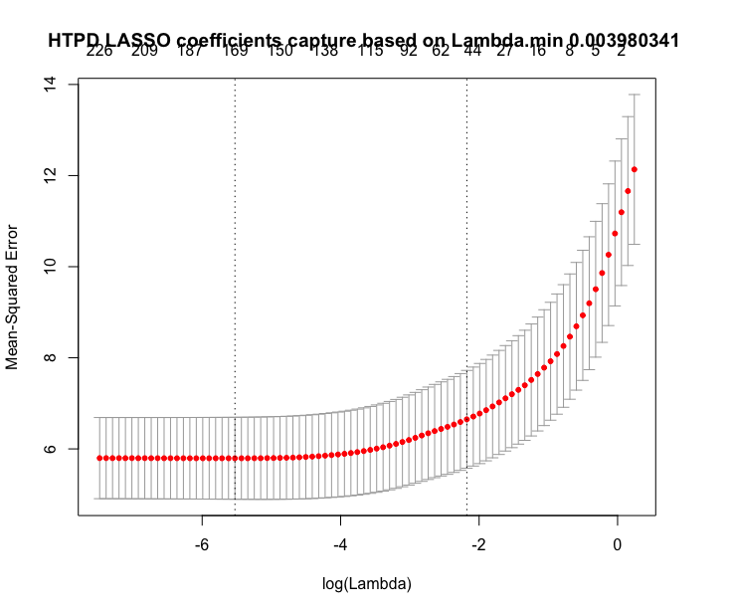
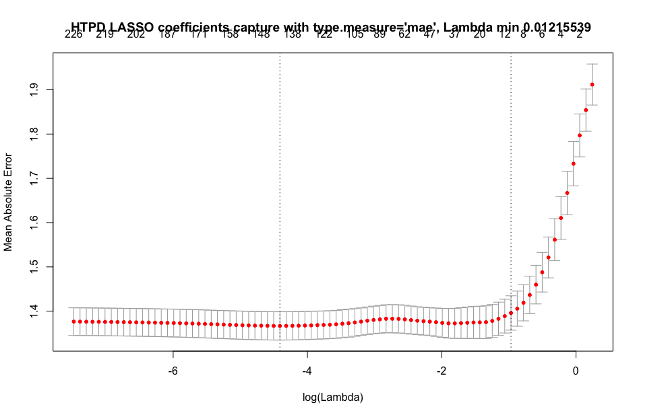

Slide 43
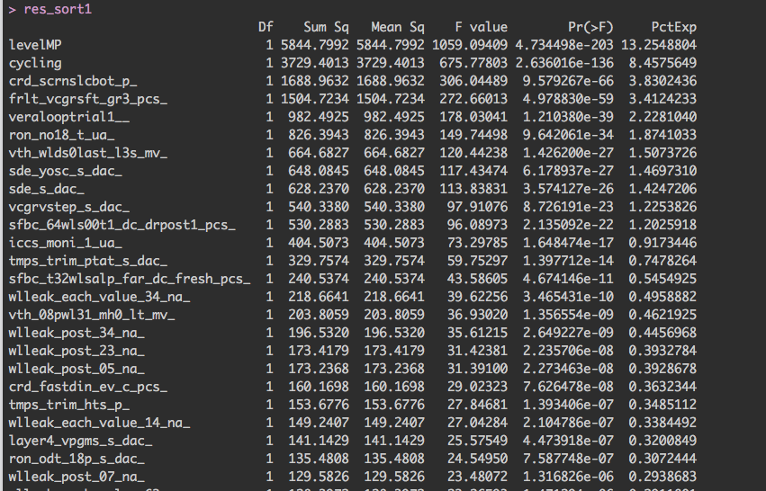
HTPD Lasso variables contribution

Slide 45
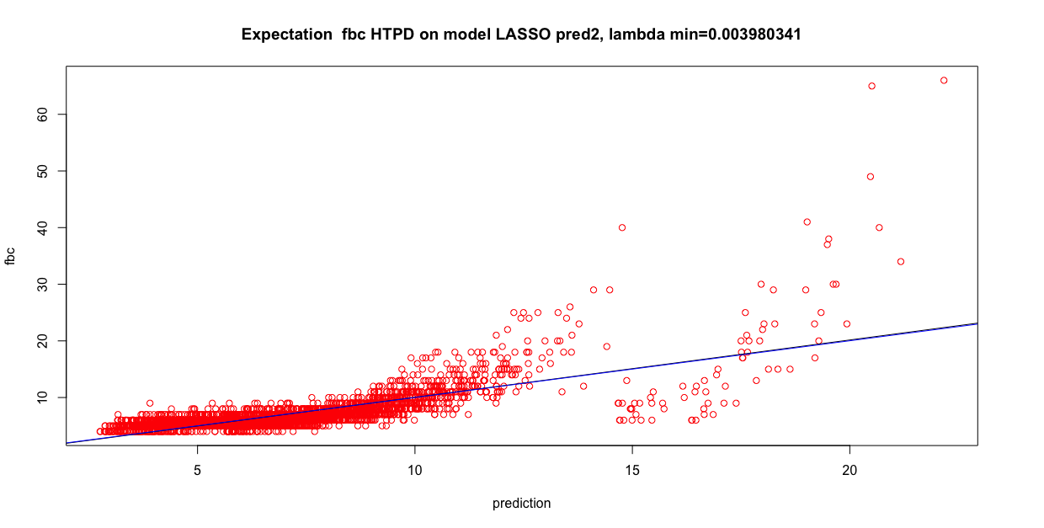

Slide 46
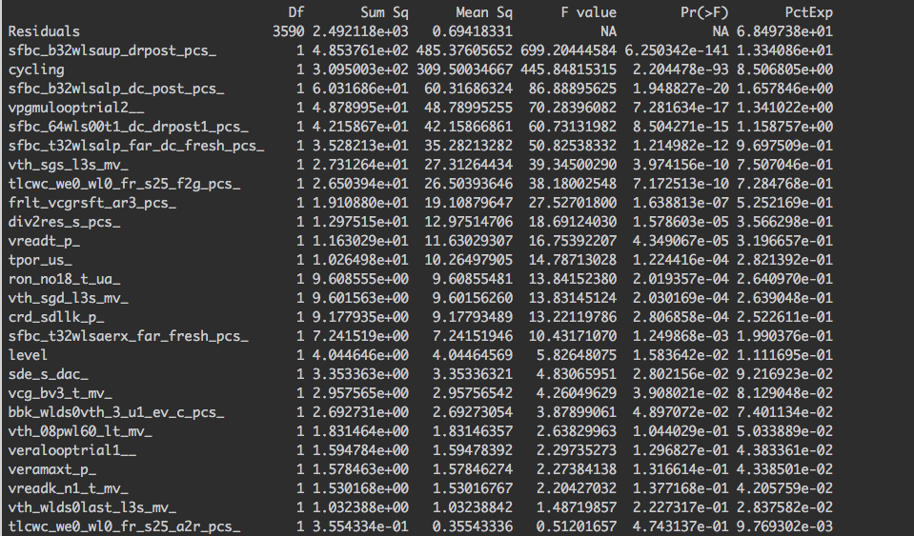
GBM contribution in HTPD set

Slide 47
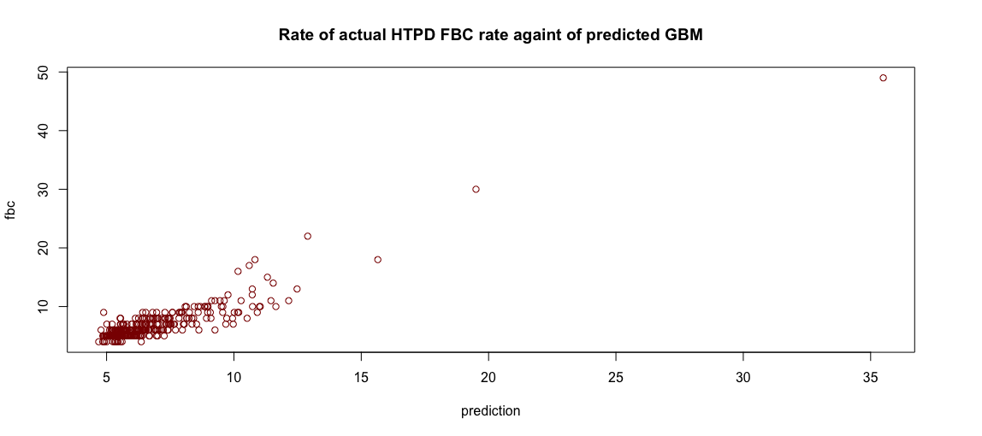

Slide 48
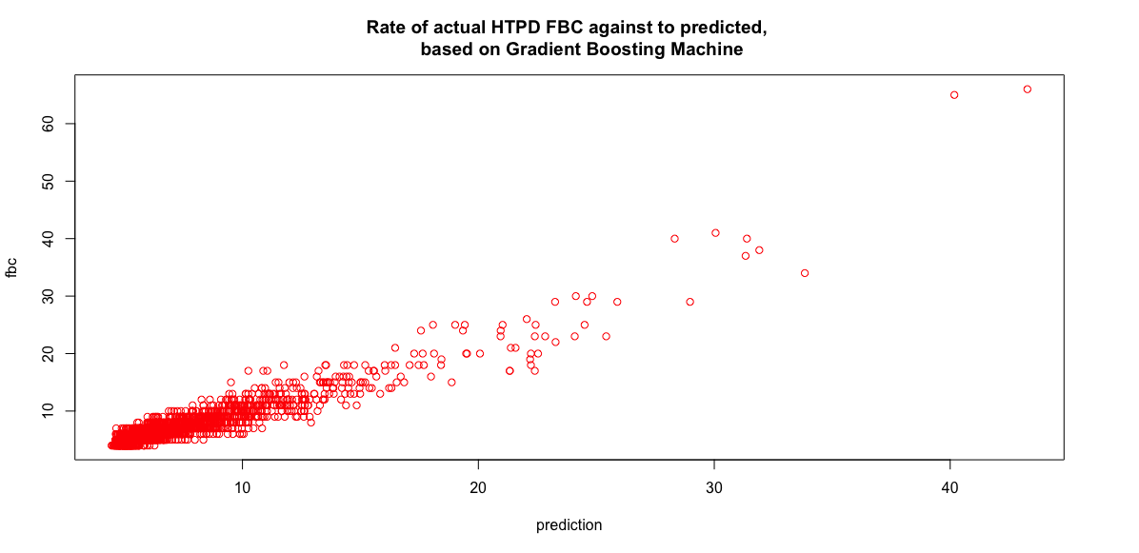

Slide 51
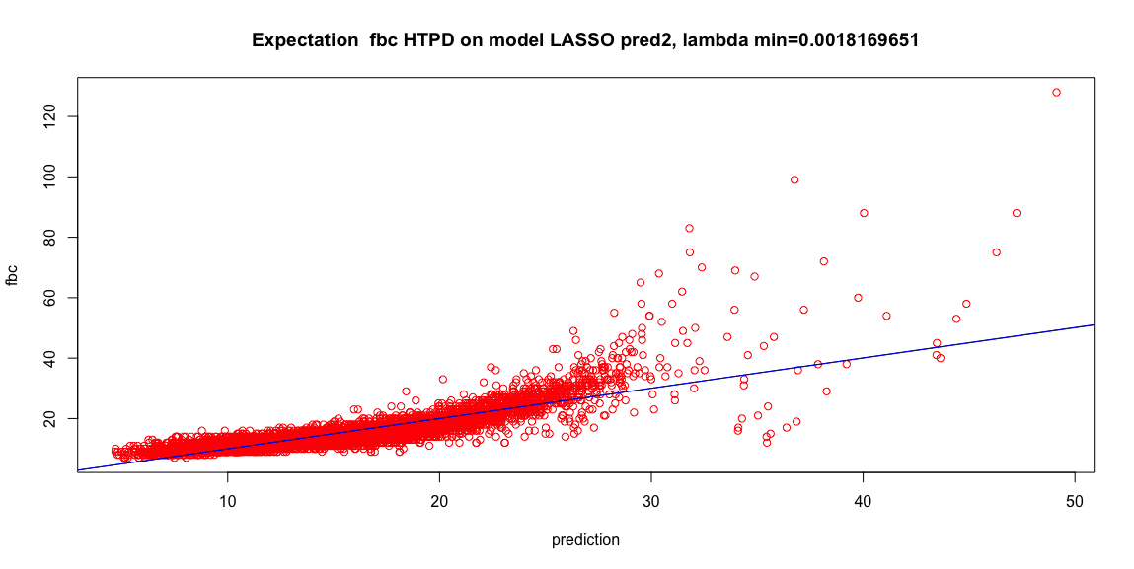

Slide 52
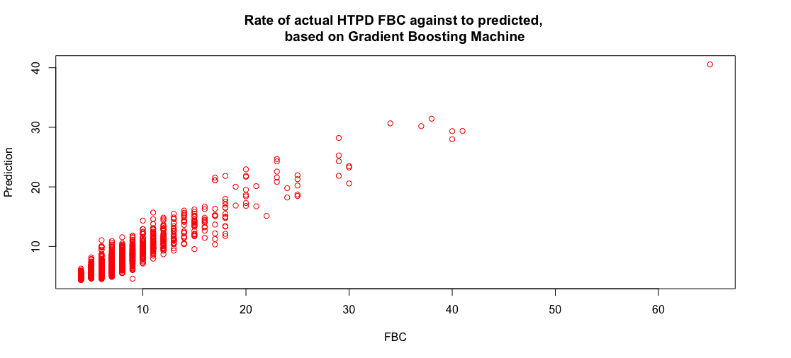

Slide 53
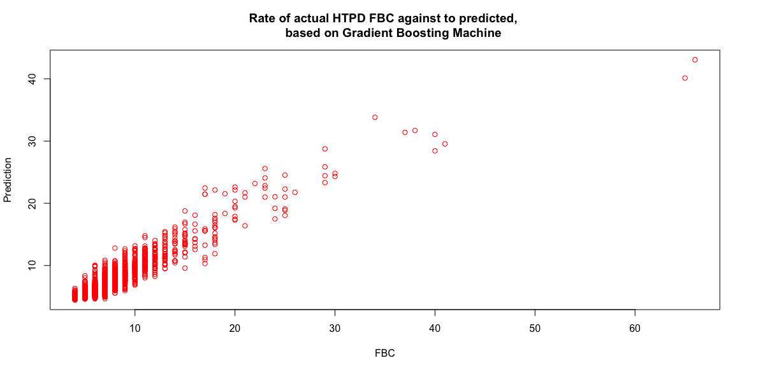

Slide 54
RTPD
Lasso RTPD
GBM RTPD
sgdprog_prog_pass__ | 13.61310237
levelMP | 9.375730149
vera_mlc_rate__ | 7.047967039
tpd_ns_ | 6.665157773
crd_scrnslcbot_p_ | 1.531178286
levelUP | 1.354612182
vera_mlc_delta_loop_mv_ | 1.25437076
vpass2_s_dac_ | 1.201906589
sgdprog_erase_pass__ | 1.030521216
sde_yosc_s_dac_ | 0.880655569
vpass1_s_dac_ | 0.814609849
ersloop_mv_ | 0.704147364
bbk_wlhr_1_d_pcs_ | 0.700460267
vfour_s_dac_ | 0.695972936
sde_pmp_vm_s_dac_ | 0.546446788
crd_adl1_1vdd_p_ | 0.521008255
vcgrvstep_s_dac_ | 0.49067066
crd_blleak1_p_ | 0.415501552
frlt_vcgrsft_er3_pcs_ | 0.415013897
vdda_s_dac_ | 0.408170704
level | 23.07845581
cycling | 20.63369951
vth_08pwl60_lt_mv_ | 7.325696153
sfbc_b32wlsaup_drpost_pcs_ | 5.072672386
crd_scrnslcbot_p_ | 4.957840306
bbk_high_wldd0_ev_d_pcs_ | 2.988857434
tlcwc_we0_wl31_fr_s25_f2g_pcs_ | 2.76685991
vpgmslooptrial1__ | 2.75268813
sfbc_t32wlsaerx_far_fresh_pcs_ | 2.482602541
sfbc_t32wlsalp_far_fresh_pcs_ | 1.697639099
sfbc_b32wlsalp_dc_post_pcs_ | 1.555269041
vth_wlds0last_l3s_mv_ | 1.507003829
sfbc_t32wlsalp_far_dc_fresh_pcs_ | 1.224965536
vpgmulooptrial2__ | 1.124216167
eires20x1__ | 1.108965524
bbk_wlds0vth_3_u1_ev_c_pcs_ | 1.076279552
vth_sgs_med_mv_ | 0.963287393
sfbc_64wls00t1_dc_drpost1_pcs_ | 0.921373709
tlcwc_we0_wl0_fr_s25_f2g_pcs_ | 0.766052699
crd_m1bll_224_c_pcs_ | 0.689337839
levelMP | 4.280931358
crd_scrnslcbot_p_ | 0.468790638
layer4_vpgmu_s_dac_ | 0.187644719
layer3_vpgms_s_dac_ | 0.050567618
vth_wlds0last_l3s_mv_ | 0.002390201
cycling | 0.001447332
sfbc_b32wlsaup_drpost_pcs_ | 0.001019435
sfbc_b32wlsalp_dc_post_pcs_ | 0.000448507
sfbc_t32wlsalp_far_dc_fresh_pcs_ | 0.000201112
crd_m1bll_224_c_pcs_ | 1.22E-05
ron_no33_s_dac_ | -0.081924224
vpgmulooptrial2__ | -0.638392908

Slide 55
LASSO mae for RTPD
levelMP | 4.280931358
crd_scrnslcbot_p_ | 0.468790638
layer4_vpgmu_s_dac_ | 0.187644719
layer3_vpgms_s_dac_ | 0.050567618
vth_wlds0last_l3s_mv_ | 0.002390201
cycling | 0.001447332
sfbc_b32wlsaup_drpost_pcs_ | 0.001019435
sfbc_b32wlsalp_dc_post_pcs_ | 0.000448507
sfbc_t32wlsalp_far_dc_fresh_pcs_ | 0.000201112
crd_m1bll_224_c_pcs_ | 1.22E-05
ron_no33_s_dac_ | -0.081924224
vpgmulooptrial2__ | -0.638392908
levelMP | 4.280931358
crd_scrnslcbot_p_ | 0.468790638
layer4_vpgmu_s_dac_ | 0.187644719
layer3_vpgms_s_dac_ | 0.050567618
vth_wlds0last_l3s_mv_ | 0.002390201
cycling | 0.001447332
sfbc_b32wlsaup_drpost_pcs_ | 0.001019435
Lasso mae give limited result with
12 predictors

Slide 56
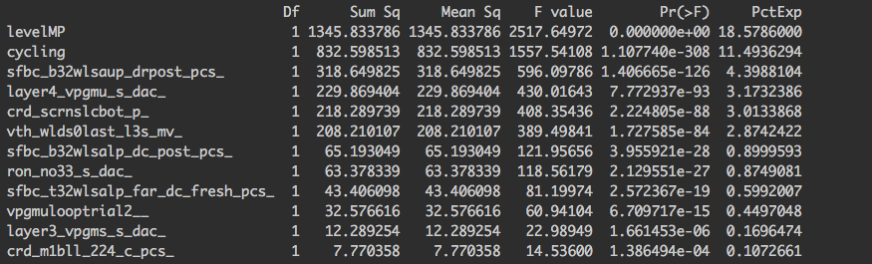

Slide 57
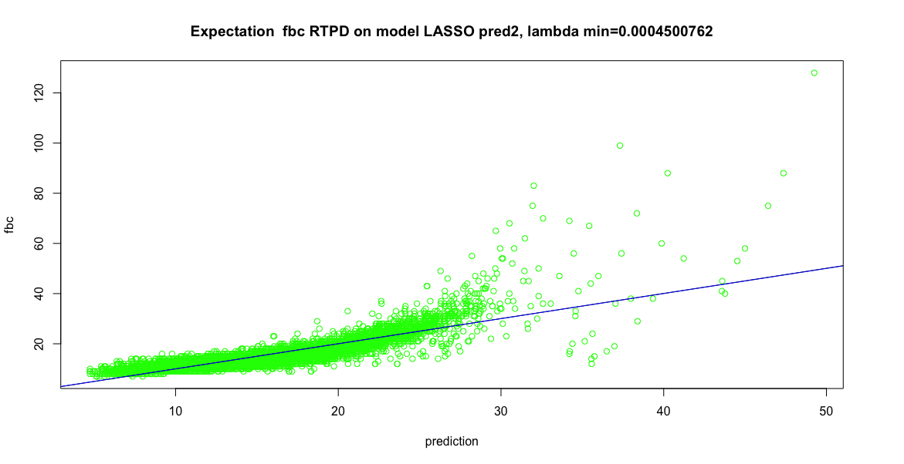
LASSO RTPD prediction plot

Slide 58
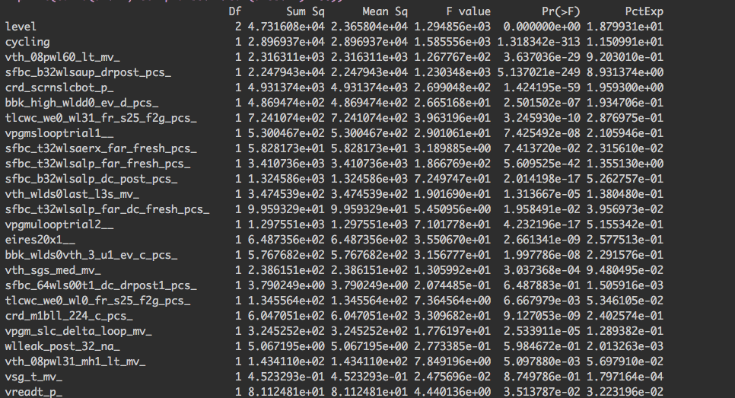

Slide 59
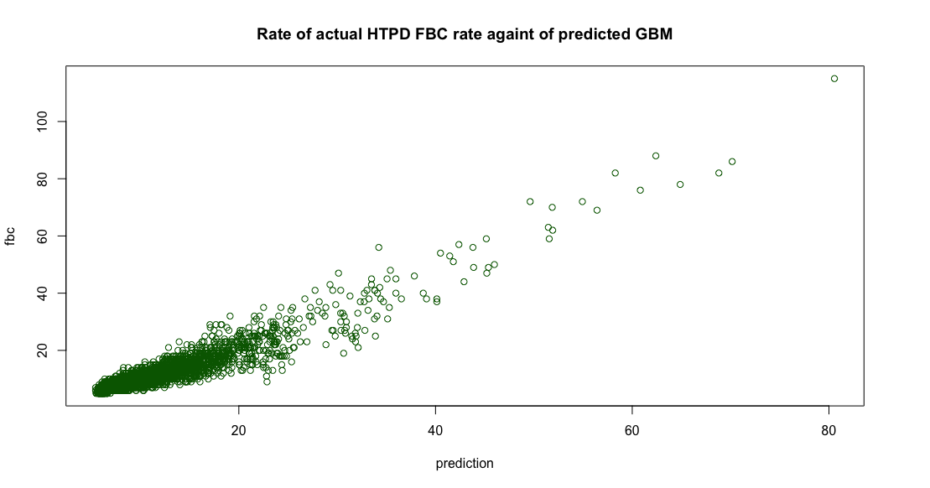
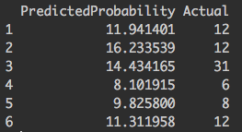

Slide 60
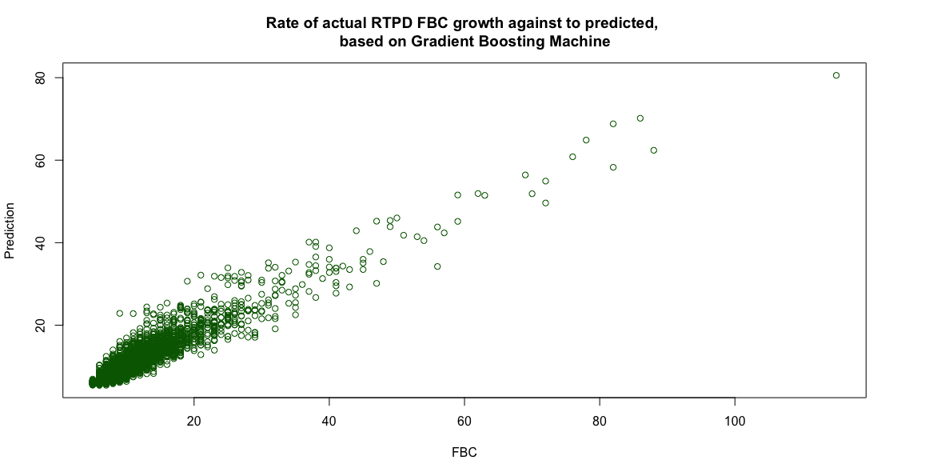

Slide 61
Lasso LTPD
GBM LTPD
levelMP | 9.23E+00
vera_mlc_rate__ | 6.68E+00
crd_scrnslcbot_p_ | 1.32E+00
levelUP | 1.21E+00
vera_mlc_delta_loop_mv_ | 1.12E+00
vpass1_s_dac_ | 7.25E-01
layer3_vpgms_s_dac_ | 3.16E-01
vpgmslooptrial1__ | 2.57E-01
bbk_wlhr_1_d_pcs_ | 2.49E-01
vpass2_s_dac_ | 2.07E-01
vpgmu_bwl_s_dac_ | 1.56E-01
sde_yosc_s_dac_ | 1.35E-01
crd_blleak1_p_ | 1.18E-01
veralooptrial1__ | 1.01E-01
halfvccq_s_dac_ | 9.57E-02
bbk_sgsld_1_d_pcs_ | 8.86E-02
bbk_slcreadrand_d_pcs_ | 8.03E-02
sde_pmp_vm_s_dac_ | 7.97E-02
crd_m1bll_slc1_p_ | 6.53E-02
frlt_vcgrsft_cr3_pcs_ | 6.53E-02
var | rel.inf
level | 42.52515514
cycling | 15.310265
sfbc_b32wlsaup_drpost_pcs_ | 6.969531606
vpgmslooptrial1__ | 4.502103778
vth_08pwl60_lt_mv_ | 2.510947903
sfbc_t32wlsalp_far_dc_fresh_pcs_ | 1.891011053
sfbc_t32wlsaerx_far_fresh_pcs_ | 1.818201732
crd_scrnslcbot_p_ | 1.740234182
tlcwc_we0_wl0_fr_s25_f2g_pcs_ | 1.690977146
vth_wlds0last_l3s_mv_ | 1.677690961
sfbc_b32wlsalp_dc_post_pcs_ | 1.57994324
tlcwc_we0_wl31_fr_s25_f2g_pcs_ | 1.362318815
bbk_high_wldd0_ev_d_pcs_ | 1.192493056
fbc_sdllk4_pcs_ | 1.190281721
crd_m1bll_224_c_pcs_ | 0.933465832
vth_sgs_med_mv_ | 0.786905112
layer3_vpgms_s_dac_ | 0.576303064
wlleak_post_32_na_ | 0.518179847
vref_t_mv_ | 0.452485837

Slide 62
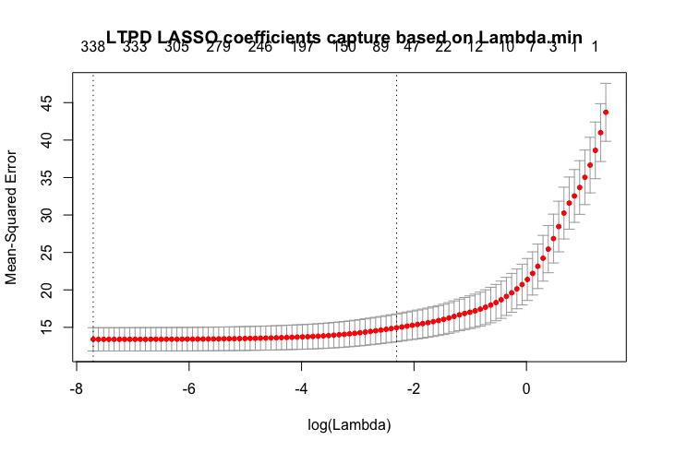


Slide 63


Slide 64


Slide 65


Slide 66


Slide 67


Slide 68

Lasso variables contributions LTPD

Slide 69

GBM contribution

Slide 70
HTPD variable contribution base on Lasso
 | Df | Sum Sq | Mean Sq | F value | Pr(>F) | PctExp
levelMP | 1 | 2780.704352 | 2780.704352 | 9262.359403 | 0 | 38.38631077
cycling | 1 | 617.3664622 | 617.3664622 | 2056.410654 | 0 | 8.522452542
vpgmslooptrial1__ | 1 | 431.1852724 | 431.1852724 | 1436.252279 | 2.40E-286 | 5.952309117
crd_scrnslcbot_p_ | 1 | 129.035725 | 129.035725 | 429.8102602 | 9.68E-93 | 1.781277264
layer3_vpgms_s_dac_ | 1 | 120.1226806 | 120.1226806 | 400.1214437 | 1.23E-86 | 1.658236893
sfbc_b32wlsaup_drpost_pcs_ | 1 | 117.7438943 | 117.7438943 | 392.1978494 | 5.30E-85 | 1.625398873
vth_wlds0last_l3s_mv_ | 1 | 75.87547165 | 75.87547165 | 252.7366449 | 6.05E-56 | 1.047425064
sfbc_t32wlsalp_far_fresh_pcs_ | 1 | 56.6369939 | 56.6369939 | 188.6544294 | 2.18E-42 | 0.781846962
bbk_sgsld_1_d_pcs_ | 1 | 52.31746176 | 52.31746176 | 174.266327 | 2.51E-39 | 0.72221786
levelUP | 1 | 50.70994086 | 50.70994086 | 168.9117713 | 3.49E-38 | 0.700026793
frlt_vcgrsft_cr3_pcs_ | 1 | 46.96652396 | 46.96652396 | 156.4426741 | 1.60E-35 | 0.64835069
tlcwc_we0_wl0_fr_s25_f2g_pcs_ | 1 | 33.0247069 | 33.0247069 | 110.0033178 | 1.50E-25 | 0.455890487
eires20x1__ | 1 | 30.9400125 | 30.9400125 | 103.0593258 | 4.75E-24 | 0.427112265
vpass1_s_dac_ | 1 | 27.39548509 | 27.39548509 | 91.2527176 | 1.70E-21 | 0.378181738
vera_mlc_rate__ | 1 | 23.5819139 | 23.5819139 | 78.5499407 | 9.73E-19 | 0.325537188
veralooptrial1__ | 1 | 15.0870329 | 15.0870329 | 50.25400162 | 1.48E-12 | 0.208269366
wlleak_each_value_46_na_ | 1 | 14.62217267 | 14.62217267 | 48.7055801 | 3.24E-12 | 0.20185219
fbc_sdllk2_pcs_ | 1 | 14.41257414 | 14.41257414 | 48.00741997 | 4.62E-12 | 0.198958782
ron_no33_s_dac_ | 1 | 14.21733982 | 14.21733982 | 47.35710615 | 6.42E-12 | 0.196263664

Slide 71
 | Df | Sum Sq | Mean Sq | F value | Pr(>F) | PctExp
level | 2 | 5893.819939 | 2946.90997 | 438.1332985 | 5.61E-171 | 13.36604997
cycling | 1 | 3751.114105 | 3751.114105 | 557.6987465 | 9.82E-115 | 8.50680528
sfbc_b32wlsaup_drpost_pcs_ | 1 | 5882.710606 | 5882.710606 | 874.6149115 | 3.27E-172 | 13.34085614
vth_08pwl60_lt_mv_ | 1 | 22.19716037 | 22.19716037 | 3.300173806 | 0.069355931 | 0.05033889
sfbc_t32wlsaerx_far_fresh_pcs_ | 1 | 87.76651173 | 87.76651173 | 13.04872958 | 0.000307647 | 0.199037567
ron_no18_t_ua_ | 1 | 116.4547499 | 116.4547499 | 17.31396759 | 3.24E-05 | 0.264096973
vth_sgd_l3s_mv_ | 1 | 105.0931392 | 105.0931392 | 15.6247745 | 7.87E-05 | 0.238331026
sfbc_b32wlsalp_dc_post_pcs_ | 1 | 737.7069124 | 737.7069124 | 109.6789404 | 2.66E-25 | 1.672977383
tlcwc_we0_wl0_fr_s25_a2r_pcs_ | 1 | 8.912288382 | 8.912288382 | 1.325038887 | 0.249766408 | 0.020211356
tlcwc_we0_wl0_fr_s25_f2g_pcs_ | 1 | 321.2251326 | 321.2251326 | 47.7583056 | 5.68E-12 | 0.728476814
sfbc_t32wlsalp_far_dc_fresh_pcs_ | 1 | 427.6160189 | 427.6160189 | 63.57602329 | 2.06E-15 | 0.969750881
vth_sgs_l3s_mv_ | 1 | 347.6732364 | 347.6732364 | 51.69049053 | 7.87E-13 | 0.788456027
sfbc_64wls00t1_dc_drpost1_pcs_ | 1 | 688.8745834 | 688.8745834 | 102.4187697 | 9.34E-24 | 1.562235053
vreadt_p_ | 1 | 101.9787297 | 101.9787297 | 15.16173812 | 0.000100478 | 0.231268144
sde_s_dac_ | 1 | 16.59697082 | 16.59697082 | 2.467562853 | 0.116306153 | 0.037638737
vreadk_n1_t_mv_ | 1 | 16.80435142 | 16.80435142 | 2.498395266 | 0.114050487 | 0.038109037
veramaxt_p_ | 1 | 3.512957905 | 3.512957905 | 0.522290756 | 0.469913233 | 0.007966713
vpgmulooptrial2__ | 1 | 699.8870375 | 699.8870375 | 104.0560518 | 4.18E-24 | 1.587209181
frlt_vcgrsft_ar3_pcs_ | 1 | 123.1247859 | 123.1247859 | 18.30563849 | 1.93E-05 | 0.279223332

Slide 72
RTPD Variables Contribution of LASSO
 | Df | Sum Sq | Mean Sq | F value | Pr(>F) | PctExp
Residuals | 7232 | 4736.284591 | 0.654906608 | NA | NA | 65.38217271
levelMP | 1 | 475.4841054 | 475.4841054 | 726.0334518 | 1.80E-152 | 6.563833592
sfbc_b32wlsaup_drpost_pcs_ | 1 | 318.6498252 | 318.6498252 | 486.5576575 | 2.09E-104 | 4.398810397
layer4_vpgmu_s_dac_ | 1 | 229.869404 | 229.869404 | 350.9957008 | 1.63E-76 | 3.173238597
crd_scrnslcbot_p_ | 1 | 218.2897389 | 218.2897389 | 333.3143018 | 7.75E-73 | 3.013386788
vth_wlds0last_l3s_mv_ | 1 | 208.2101071 | 208.2101071 | 317.9233565 | 1.25E-69 | 2.87424223
sfbc_b32wlsalp_dc_post_pcs_ | 1 | 65.1930486 | 65.1930486 | 99.54556539 | 2.71E-23 | 0.899959257
ron_no33_s_dac_ | 1 | 63.37833934 | 63.37833934 | 96.77462182 | 1.08E-22 | 0.874908053
sfbc_t32wlsalp_far_dc_fresh_pcs_ | 1 | 43.4060985 | 43.4060985 | 66.27830281 | 4.57E-16 | 0.599200697
vpgmulooptrial2__ | 1 | 32.57661631 | 32.57661631 | 49.74238448 | 1.92E-12 | 0.449704808
layer3_vpgms_s_dac_ | 1 | 12.28925431 | 12.28925431 | 18.76489587 | 1.50E-05 | 0.169647354
crd_m1bll_224_c_pcs_ | 1 | 7.770358046 | 7.770358046 | 11.86483378 | 0.000575286 | 0.107266124

Slide 73
RTPD Variables Contribution with Lasso Model
 | Df | Sum Sq | Mean Sq | F value | Pr(>F) | PctExp
Residuals | 7232 | 4736.284591 | 0.654906608 | NA | NA | 65.38217271
levelMP | 1 | 475.4841054 | 475.4841054 | 726.0334518 | 1.80E-152 | 6.563833592
sfbc_b32wlsaup_drpost_pcs_ | 1 | 318.6498252 | 318.6498252 | 486.5576575 | 2.09E-104 | 4.398810397
layer4_vpgmu_s_dac_ | 1 | 229.869404 | 229.869404 | 350.9957008 | 1.63E-76 | 3.173238597
crd_scrnslcbot_p_ | 1 | 218.2897389 | 218.2897389 | 333.3143018 | 7.75E-73 | 3.013386788
vth_wlds0last_l3s_mv_ | 1 | 208.2101071 | 208.2101071 | 317.9233565 | 1.25E-69 | 2.87424223
sfbc_b32wlsalp_dc_post_pcs_ | 1 | 65.1930486 | 65.1930486 | 99.54556539 | 2.71E-23 | 0.899959257
ron_no33_s_dac_ | 1 | 63.37833934 | 63.37833934 | 96.77462182 | 1.08E-22 | 0.874908053
sfbc_t32wlsalp_far_dc_fresh_pcs_ | 1 | 43.4060985 | 43.4060985 | 66.27830281 | 4.57E-16 | 0.599200697
vpgmulooptrial2__ | 1 | 32.57661631 | 32.57661631 | 49.74238448 | 1.92E-12 | 0.449704808
layer3_vpgms_s_dac_ | 1 | 12.28925431 | 12.28925431 | 18.76489587 | 1.50E-05 | 0.169647354
crd_m1bll_224_c_pcs_ | 1 | 7.770358046 | 7.770358046 | 11.86483378 | 0.000575286 | 0.107266124

Slide 74
RTPD contribution variables by standardized GBM
 | Df | Sum Sq | Mean Sq | F value | Pr(>F) | PctExp
level | 2 | 5893.819939 | 2946.90997 | 438.1332985 | 5.61E-171 | 13.36604997
cycling | 1 | 3751.114105 | 3751.114105 | 557.6987465 | 9.82E-115 | 8.50680528
sfbc_b32wlsaup_drpost_pcs_ | 1 | 5882.710606 | 5882.710606 | 874.6149115 | 3.27E-172 | 13.34085614
vth_08pwl60_lt_mv_ | 1 | 22.19716037 | 22.19716037 | 3.300173806 | 0.069355931 | 0.05033889
sfbc_t32wlsaerx_far_fresh_pcs_ | 1 | 87.76651173 | 87.76651173 | 13.04872958 | 0.000307647 | 0.199037567
ron_no18_t_ua_ | 1 | 116.4547499 | 116.4547499 | 17.31396759 | 3.24E-05 | 0.264096973
vth_sgd_l3s_mv_ | 1 | 105.0931392 | 105.0931392 | 15.6247745 | 7.87E-05 | 0.238331026
sfbc_b32wlsalp_dc_post_pcs_ | 1 | 737.7069124 | 737.7069124 | 109.6789404 | 2.66E-25 | 1.672977383
tlcwc_we0_wl0_fr_s25_a2r_pcs_ | 1 | 8.912288382 | 8.912288382 | 1.325038887 | 0.249766408 | 0.020211356
tlcwc_we0_wl0_fr_s25_f2g_pcs_ | 1 | 321.2251326 | 321.2251326 | 47.7583056 | 5.68E-12 | 0.728476814
sfbc_t32wlsalp_far_dc_fresh_pcs_ | 1 | 427.6160189 | 427.6160189 | 63.57602329 | 2.06E-15 | 0.969750881
vth_sgs_l3s_mv_ | 1 | 347.6732364 | 347.6732364 | 51.69049053 | 7.87E-13 | 0.788456027
sfbc_64wls00t1_dc_drpost1_pcs_ | 1 | 688.8745834 | 688.8745834 | 102.4187697 | 9.34E-24 | 1.562235053
vreadt_p_ | 1 | 101.9787297 | 101.9787297 | 15.16173812 | 0.000100478 | 0.231268144
sde_s_dac_ | 1 | 16.59697082 | 16.59697082 | 2.467562853 | 0.116306153 | 0.037638737
vreadk_n1_t_mv_ | 1 | 16.80435142 | 16.80435142 | 2.498395266 | 0.114050487 | 0.038109037
veramaxt_p_ | 1 | 3.512957905 | 3.512957905 | 0.522290756 | 0.469913233 | 0.007966713
vpgmulooptrial2__ | 1 | 699.8870375 | 699.8870375 | 104.0560518 | 4.18E-24 | 1.587209181
frlt_vcgrsft_ar3_pcs_ | 1 | 123.1247859 | 123.1247859 | 18.30563849 | 1.93E-05 | 0.279223332
vth_wlds0last_l3s_mv_ | 1 | 13.89940762 | 13.89940762 | 2.066501309 | 0.150653763 | 0.031521183
tpor_us_ | 1 | 8.759482925 | 8.759482925 | 1.30232046 | 0.253865938 | 0.019864822

Slide 75
LTPD contribution variables by standardized LASSO
LTPD variables contribution by Lasso model
 | Df | Sum Sq | Mean Sq | F value | Pr(>F) | PctExp
levelMP | 1 | 2780.704352 | 2780.704352 | 9267.885332 | 0 | 38.38631077
cycling | 1 | 617.2704114 | 617.2704114 | 2057.31738 | 0 | 8.521126606
vpgmslooptrial1__ | 1 | 431.1852724 | 431.1852724 | 1437.109148 | 1.65E-286 | 5.952309117
crd_scrnslcbot_p_ | 1 | 129.035725 | 129.035725 | 430.0666852 | 8.56E-93 | 1.781277264
layer3_vpgms_s_dac_ | 1 | 120.1226806 | 120.1226806 | 400.3601564 | 1.10E-86 | 1.658236893
sfbc_b32wlsaup_drpost_pcs_ | 1 | 115.8119161 | 115.8119161 | 385.9926919 | 1.01E-83 | 1.598728825
vth_wlds0last_l3s_mv_ | 1 | 76.73001528 | 76.73001528 | 255.7355594 | 1.41E-56 | 1.059221636
bbk_sgsld_1_d_pcs_ | 1 | 58.22113018 | 58.22113018 | 194.0467918 | 1.55E-43 | 0.803715215
sfbc_t32wlsalp_far_fresh_pcs_ | 1 | 55.58449882 | 55.58449882 | 185.2590913 | 1.15E-41 | 0.767317764
levelUP | 1 | 50.70994086 | 50.70994086 | 169.0125441 | 3.32E-38 | 0.700026793
frlt_vcgrsft_cr3_pcs_ | 1 | 46.96652396 | 46.96652396 | 156.5360079 | 1.53E-35 | 0.64835069
tlcwc_we0_wl0_fr_s25_f2g_pcs_ | 1 | 33.0247069 | 33.0247069 | 110.0689458 | 1.46E-25 | 0.455890487
vpass1_s_dac_ | 1 | 27.39548509 | 27.39548509 | 91.30715902 | 1.66E-21 | 0.378181738
vera_mlc_rate__ | 1 | 23.5819139 | 23.5819139 | 78.59680364 | 9.51E-19 | 0.325537188
eires20x1__ | 1 | 23.39559047 | 23.39559047 | 77.97580121 | 1.30E-18 | 0.322965081
wlleak_each_value_46_na_ | 1 | 15.17166608 | 15.17166608 | 50.56605942 | 1.26E-12 | 0.209437687
wlleak_each_value_53_na_ | 1 | 14.29263226 | 14.29263226 | 47.63630364 | 5.57E-12 | 0.197303041
fbc_sdllk2_pcs_ | 1 | 14.00574789 | 14.00574789 | 46.68013891 | 9.05E-12 | 0.193342737
wlleak_post_00_na_ | 1 | 13.4597989 | 13.4597989 | 44.86053063 | 2.28E-11 | 0.185806169
sfbc_b32wlsalp_drpost_pcs_ | 1 | 13.43465892 | 13.43465892 | 44.77674092 | 2.38E-11 | 0.185459124

Slide 76
LTPD contribution variables by standardized GBM
 | Df | Sum Sq | Mean Sq | F value | Pr(>F) | PctExp
sfbc_b32wlsaup_drpost_pcs_ | 1 | 720.2784585 | 720.2784585 | 978.4439075 | 1.56E-201 | 9.943104065
cycling | 1 | 617.9583388 | 617.9583388 | 839.4497497 | 1.07E-174 | 8.53062312
vpgmslooptrial1__ | 1 | 102.4287923 | 102.4287923 | 139.1417813 | 8.03E-32 | 1.413981119
sfbc_t32wlsalp_far_dc_fresh_pcs_ | 1 | 98.91367443 | 98.91367443 | 134.3667591 | 8.50E-31 | 1.365456577
crd_scrnslcbot_p_ | 1 | 83.60347668 | 83.60347668 | 113.5690113 | 2.54E-26 | 1.154106525
level | 1 | 50.70994086 | 50.70994086 | 68.88562624 | 1.23E-16 | 0.700026793
vth_wlds0last_l3s_mv_ | 1 | 45.27185565 | 45.27185565 | 61.49839804 | 5.07E-15 | 0.624956594
tproga2slc_wl24_us_ | 1 | 30.17796189 | 30.17796189 | 40.99448291 | 1.62E-10 | 0.416592516
layer3_vpgms_s_dac_ | 1 | 24.19895669 | 24.19895669 | 32.87245573 | 1.02E-08 | 0.334055172
fbc_sdllk4_pcs_ | 1 | 23.71164802 | 23.71164802 | 32.21048369 | 1.44E-08 | 0.327328106
crd_m1bll_224_c_pcs_ | 1 | 20.79674695 | 20.79674695 | 28.25081066 | 1.10E-07 | 0.287089273
tlcwc_we0_wl0_fr_s25_f2g_pcs_ | 1 | 17.08216349 | 17.08216349 | 23.20482947 | 1.49E-06 | 0.235811202
vth_08pwl60_lt_mv_ | 1 | 17.03530684 | 17.03530684 | 23.14117824 | 1.54E-06 | 0.235164368
sfbc_t32wlsalp_far_fresh_pcs_ | 1 | 16.28323249 | 16.28323249 | 22.11954202 | 2.61E-06 | 0.224782337
sfbc_b32wlsaerx_fresh_pcs_ | 1 | 12.44443721 | 12.44443721 | 16.90482844 | 3.97E-05 | 0.17178958
vth_sgs_med_mv_ | 1 | 11.59672794 | 11.59672794 | 15.7532794 | 7.29E-05 | 0.160087354
bbk_high_wldd0_ev_d_pcs_ | 1 | 8.639946902 | 8.639946902 | 11.73671558 | 0.000616208 | 0.119270388
bbk_wlds0vth_3_u1_ev_c_pcs_ | 1 | 8.327327334 | 8.327327334 | 11.3120455 | 0.000774069 | 0.114954822
wlleak_post_33_na_ | 1 | 6.158918881 | 6.158918881 | 8.366426324 | 0.003833597 | 0.085020967

Slide 77
Data engineering
Retrieved Diequal data by max FBC from htpd, rtpd and ltpd test.
Combining data with Diesort parametrs.
HTPD
DS
18231 x 1781
Table for cleaning
DQ+
T
RTPD
LTPD

Slide 78
Contrivution of variables of Cross Temp Lasso model
 | Df | Sum Sq | Mean Sq | F value | Pr(>F) | PctExp
Residuals | 17805 | 6029.142346 | 0.338620744 | NA | NA | 33.29178545
levelMP | 1 | 3432.402252 | 3432.402252 | 10136.4205 | 0 | 18.95307704
cycling | 1 | 1276.559044 | 1276.559044 | 3769.878445 | 0 | 7.048917966
eires20x1__ | 1 | 284.9685207 | 284.9685207 | 841.5565964 | 7.84E-181 | 1.573542356
vth_sgs_med_mv_ | 1 | 155.5935179 | 155.5935179 | 459.4919854 | 1.16E-100 | 0.859158023
vth_wlds1_med_mv_ | 1 | 121.4989217 | 121.4989217 | 358.8053119 | 3.08E-79 | 0.670894101
sde_yosc_s_dac_ | 1 | 84.36386213 | 84.36386213 | 249.1396751 | 9.55E-56 | 0.465841315
vpass3_t_mv_ | 1 | 72.96287517 | 72.96287517 | 215.4707781 | 1.69E-48 | 0.402887218
vf_sk_mv_ | 1 | 71.6935651 | 71.6935651 | 211.722307 | 1.09E-47 | 0.395878327
crd_ttl_pl0_p_ | 1 | 71.22688048 | 71.22688048 | 210.3441143 | 2.15E-47 | 0.393301383
wlleak_each_value_09_na_ | 1 | 64.74757704 | 64.74757704 | 191.2097182 | 2.90E-43 | 0.357523893
vth_wlds0last_l3s_mv_ | 1 | 60.79197624 | 60.79197624 | 179.5282106 | 9.68E-41 | 0.335681813
bbk_mlcread2_d_pcs_ | 1 | 57.20283438 | 57.20283438 | 168.9289136 | 1.90E-38 | 0.315863249
frlt_vcgrsft_cr3_pcs_ | 1 | 56.99513383 | 56.99513383 | 168.3155414 | 2.58E-38 | 0.314716366
wlleak_each_value_16_na_ | 1 | 54.63043434 | 54.63043434 | 161.332214 | 8.36E-37 | 0.301658942
sde_pmp_vm_s_dac_ | 1 | 51.2720346 | 51.2720346 | 151.4143345 | 1.18E-34 | 0.283114493
bbk_mhopen1_000_vblc050_ev_c_pcs_ | 1 | 48.5833312 | 48.5833312 | 143.474173 | 6.20E-33 | 0.26826798
fifthratio__ | 1 | 47.70551257 | 47.70551257 | 140.8818374 | 2.26E-32 | 0.263420831
wlleak_each_value_62_na_ | 1 | 47.54429965 | 47.54429965 | 140.4057504 | 2.87E-32 | 0.262530644
crd_sdllk_p_ | 1 | 46.98932719 | 46.98932719 | 138.76683 | 6.51E-32 | 0.259466191
tpor_us_ | 1 | 45.77521961 | 45.77521961 | 135.1813804 | 3.90E-31 | 0.252762118

Slide 79


Slide 80


Slide 81

Barplot of feature selection Lasso+XGBoost+Ranger

Slide 82
Features Selection of different models and Enseble
Random Forest | Lasso | XGBoost | Ranger | Union
tem | levelMP | tem | tem | levelMP
level | vera_mlc_rate__ | levelMP | levelMP | vf_sk_mv_
cycling | levelUP | sfbc_b32wlsaup_drpost_pcs_ | sfbc_b32wlsaup_drpost_pcs_ | vth_sgs_med_mv_
sfbc_b32wlsaup_drpost_pcs_ | sde_pmp_vm_s_dac_ | cycling | crd_m1bll_224_c_pcs_ | sde_pmp_vm_s_dac_
vth_sgs_med_mv_ | crd_scrnslcbot_p_ | vth_sgs_med_mv_ | vth_sgs_med_mv_ | vth_wlds0last_l3s_mv_
sfbc_t32wlsalp_far_dc_fresh_pcs_ | vpgmu_bwl_s_dac_ | levelUP | sfbc_b32wlsaerx_fresh_pcs_ | tlcwc_we0_wl0_fr_s25_f2g_pcs_
sfbc_b32wlsalp_dc_post_pcs_ | vcgrvstep_s_dac_ | sfbc_t32wlsalp_far_dc_fresh_pcs_ | vth_wlds0last_l3s_mv_ | sfbc_b32wlsaup_drpost_pcs_
sfbc_b32wlsalp_post_pcs_ | frlt_vcgrsft_er3_pcs_ | crd_m1bll_224_c_pcs_ | sfbc_t32wlsaerx_far_fresh_pcs_ | icca_add00_ua_
fbc_sdllk4_pcs_ | treadm_us_ | sfbc_t32wlsaerx_far_fresh_pcs_ | sfbc_t12wls0erx_rdpost_pcs_ | tlcwc_we0_wl31_fr_s25_f2g_pcs_
vf_sk_mv_ | tmps_trim_bgr_s_dac_ | sfbc_b32wlsalp_dc_post_pcs_ | vth_sgs_win_mv_ | crd_m1bll_224_c_pcs_
crd_m1bll_224_c_pcs_ | bbk_sgsld_1_d_pcs_ | fbc_sdllk4_pcs_ | vf_sk_mv_ | cycling
sfbc_b32wlsalp_drpost_pcs_ | crd_blleak1_p_ | vf_sk_mv_ | sfbc_t32wlsalp_far_dc_fresh_pcs_ | sfbc_t32wlsalp_far_dc_fresh_pcs_
sfbc_t32wlsalp_far_fresh_pcs_ | layer3_vpgms_s_dac_ | sfbc_b32wlsalp_post_pcs_ | vth_12pwl3_lt_mv_ | tproga2slcrand_us_
tlcwc_we0_wl63_fr_s25_a2r_pcs_ | crd_ddbll_slc1_p_ | vth_wlds0last_l3s_mv_ | fbc_sdllk4_pcs_ | fbc_sdllk4_pcs_
halfvccq33_t_mv_ | vcg_av3_t_mv_ | sfbc_t12wls0erx_rdpost_pcs_ | vth_sgdprog_win_mv_ | sfbc_t32wlsaerx_far_fresh_pcs_
ron_odt_33n_t_ua_ | tlcwc_we0_wl63_fr_s25_a2r_pcs_ | veramaxt_p_ | sfbc_t32wlsalp_drpost_pcs_ | sfbc_t32wlsalp_drpost_pcs_
vreadhh_t_mv_ | vcg_dv3_t_mv_ | vth_12pwl3_lt_mv_ | sfbc_b32wlsalp_post_pcs_ | sfbc_t32wlsalp_far_fresh_pcs_
vx4_t_mv_ | vcelsrct_p_ | vth_08pwl60_lt_mv_ | sfbc_slcerslp_20kpost_pcs_ | tpor_us_
vcg_br3_t_mv_ | vcg_er3_t_mv_ | sfbc_b32wlsalp_drpost_pcs_ | sfbc_b32wlsalp_dc_post_pcs_ | vth_sgd_med_mv_
tlcwc_we0_wl31_fr_s25_a2r_pcs_ | wlleak_each_value_37_na_ | veralooptrial1__ | bbk_high_wldd0_ev_d_pcs_ | bbk_high_wldd0_ev_d_pcs_
vth_wlds1_med_mv_ | halfvccq18_t_mv_ | ron_po33_t_ua_ | vth_08pwl60_lt_mv_ | vth_wlds1_med_mv_
vpgmu_sgld_mon1_t_mv_ | iref_s_dac_ | icca_add00_ua_ | prgloop_wl00_mv_ | tem
veralooptrial1__ | tproga2slcrand_us_ | sfbc_b32wlsaerx_fresh_pcs_ | icca_add00_ua_ | tlcwc_we0_wl63_fr_s25_a2r_pcs_
eires20x1__ | wlleak_post_50_na_ | sde_pmp_vm_s_dac_ | frlt_vcgrsft_ar3_pcs_ | sfbc_t32wlsaerx_dc_lijl2_pcs_
vcgrv2_t_mv_ | wlleak_each_value_34_na_ | tpor_us_ | sfbc_t32wlsaerx_dc_lijl1_pcs_ | sfbc_slcerslp_20kpost_pcs_
sfbc_drtime_s_ | wlleak_post_51_na_ | crd_ttl_pl0_p_ | wlleak_each_value_24_na_ | vcg_gv3_t_mv_
sfbc_t32wlsaerx_dc_lijl1_pcs_ | bbk_mlcread2_d_pcs_ | sfbc_slcerslp_20kpost_pcs_ | sfbc_t32wlsaerx_dc_lijl2_pcs_ | vth_wlds0_win_mv_
veramaxt_p_ | wlleak_post_30_na_ | sfbc_drtime_s_ | cycling | wlleak_each_value_34_na_
vth_sgdprog_win_mv_ | wlleak_each_value_11_na_ | vth_sgdprog_win_mv_ | sfbc_slcerslp_7kpost_pcs_ | sfbc_slcerslp_7kpost_pcs_
bbk_high_wldd0_ev_d_pcs_ | wlleak_post_29_na_ | vth_sgs_win_mv_ | tlcwc_we0_wl31_fr_s25_f2g_pcs_ | vfour_t_mv_

Slide 83

Here we can see the distribution of the FBC

Slide 84


Slide 85


Slide 86
Empirically try different model …
For many machine learning algorithms, using correlated features is not a good idea. It may sometimes make prediction less accurate, and most of the time make interpretation of the model almost impossible. GLM, for instance, assumes that the features are uncorrelated.
Fortunately, decision tree algorithms (including boosted trees) are very robust to these features. Therefore we have nothing to do to manage this situation

Slide 87

Random Forest vs Ensemble Learning
Random Forest algorithm is cousin with boosting and both are part of the Ensemble Leaning family.
Both train several decision trees for one dataset. The main difference is that in Random Forests™, trees are independent and in boosting, the tree N+1 focus its learning on the loss (<=> what has not been well modeled by the tree N).

Slide 88
RF and XGBoost
Similarities:
Both derived many benefits from ensembling.
Both can be applied to ensembling decision trees
Differences
Boosting perform an exhaustive search for best predictor to split on
Boosting grows trees in series, with later trees, dependent of the result of the previous tree
GBM or XGBoost can handle missing value
Random Forest searches only small subset.
RF grows trees in parallel independently of one another.
RF can not work with missing values.

Slide 89

Ensemble learning bar plots with most of important variable for 10 fold GLMnet-Lasso, XGBoost, Ranger and Union of them.

Slide 90


Decision trees and Feature selection
 | predictors | X.IncMSE
1 | tem | 304.9397619
2 | level | 284.4364426
3 | cycling | 132.3237832
4 | sfbc_b32wlsaup_drpost_pcs_ | 24.20968849
5 | vth_sgs_med_mv_ | 17.56253193
6 | sfbc_t32wlsalp_far_dc_fresh_pcs_ | 16.70940072
7 | sfbc_b32wlsalp_dc_post_pcs_ | 13.1177299
8 | sfbc_b32wlsalp_post_pcs_ | 13.0297831
9 | fbc_sdllk4_pcs_ | 11.50225861
10 | vf_sk_mv_ | 11.10519777
11 | crd_m1bll_224_c_pcs_ | 11.0535861
12 | sfbc_b32wlsalp_drpost_pcs_ | 10.13319691
13 | sfbc_t32wlsalp_far_fresh_pcs_ | 10.06499341
14 | tlcwc_we0_wl63_fr_s25_a2r_pcs_ | 9.97536328
15 | halfvccq33_t_mv_ | 9.703217791
16 | ron_odt_33n_t_ua_ | 9.630044222
17 | vreadhh_t_mv_ | 9.148274182
18 | vx4_t_mv_ | 9.053076252
19 | vcg_br3_t_mv_ | 9.008625475
Random Forest result was impressive even with 150 trees

Slide 91
XGBoost variables

Slide 92
Most of impotent predictors at FBC growth rate by cross temperature

Slide 94


Slide 95
Contribution of the predictors selected by GBM Model
 |  | Df | Sum Sq | Mean Sq | F value | Pr(>F) | PctExp(contribution)
 | tem | 1 | 3943.46922 | 3943.46922 | 6775.028686 | 0 | 21.77509232
 | sfbc_b32wlsaup_drpost_pcs_ | 1 | 1324.447526 | 1324.447526 | 2275.450748 | 0 | 7.313349124
 | cycling | 1 | 1278.781348 | 1278.781348 | 2196.994533 | 0 | 7.061189113
 | crd_scrnslcbot_p_ | 1 | 193.7457208 | 193.7457208 | 332.8624475 | 1.05E-73 | 1.069827282
 | vth_wlds0last_l3s_mv_ | 1 | 173.5583668 | 173.5583668 | 298.1798128 | 2.79E-66 | 0.958356526
 | sfbc_b32wlsalp_dc_post_pcs_ | 1 | 130.9032518 | 130.9032518 | 224.8967183 | 1.56E-50 | 0.722823036
 | ron_no33_s_dac_ | 1 | 78.07657362 | 78.07657362 | 134.1384949 | 6.55E-31 | 0.431124095
 | crd_m1bll_224_c_pcs_ | 1 | 51.65705396 | 51.65705396 | 88.74876484 | 5.01E-21 | 0.285240497
 | layer3_vpgms_s_dac_ | 1 | 46.68787298 | 46.68787298 | 80.21152471 | 3.68E-19 | 0.257801618
 | sfbc_t32wlsalp_far_dc_fresh_pcs_ | 1 | 39.68408414 | 39.68408414 | 68.17875161 | 1.60E-16 | 0.219128018
 | level | 1 | 38.6909982 | 38.6909982 | 66.47259256 | 3.78E-16 | 0.213644385
 | vth_08pwl60_lt_mv_ | 1 | 35.47837648 | 35.47837648 | 60.95318741 | 6.16E-15 | 0.195904895
 | bbk_wlds0vth_3_u1_ev_c_pcs_ | 1 | 32.64452163 | 32.64452163 | 56.08451802 | 7.26E-14 | 0.180256884
 | vpgmulooptrial2__ | 1 | 31.11819044 | 31.11819044 | 53.46222353 | 2.75E-13 | 0.171828771
 | tlcwc_we0_wl31_fr_s25_f2g_pcs_ | 1 | 28.60093112 | 28.60093112 | 49.13747717 | 2.47E-12 | 0.15792894
 | sfbc_t32wlsalp_far_fresh_pcs_ | 1 | 26.75735366 | 26.75735366 | 45.97014164 | 1.24E-11 | 0.147749054
 | tlcwc_we0_wl0_fr_s25_f2g_pcs_ | 1 | 24.62497474 | 24.62497474 | 42.30663432 | 8.01E-11 | 0.13597446
 | eires20x1__ | 1 | 23.68477585 | 23.68477585 | 40.69133722 | 1.83E-10 | 0.130782859

Slide 97

Cross temp 1114

Slide 99
Contribution of the predictors selected by Union Model
 |  | Df | Sum Sq | Mean SQ | F Value | Pr(>F) | PetExp (contribution)
 | tem | 1 | 3949.033717 | 3949.033717 | 6464.292228 | 0 | 21.80581843
 | cycling | 1 | 1275.691781 | 1275.691781 | 2088.218297 | 0 | 7.044129103
 | vth_wlds0last_l3s_mv_ | 1 | 652.8865444 | 652.8865444 | 1068.729648 | 8.61E-228 | 3.605116203
 | crd_m1bll_224_c_pcs_ | 1 | 257.6053184 | 257.6053184 | 421.6819043 | 1.20E-92 | 1.422447921
 | wlleak_post_00_na_ | 1 | 98.7982592 | 98.7982592 | 161.7258461 | 6.84E-37 | 0.54554533
 | crd_ttl_pl0_p_ | 1 | 94.46695609 | 94.46695609 | 154.6358056 | 2.35E-35 | 0.521628692
 | vcg_slcv_t_mv_ | 1 | 76.32951402 | 76.32951402 | 124.9460804 | 6.51E-29 | 0.421477162
 | vth_sgs_med_mv_ | 1 | 70.37668221 | 70.37668221 | 115.2017107 | 8.56E-27 | 0.388606749
 | vth_wlds1_med_mv_ | 1 | 67.71780862 | 67.71780862 | 110.8493204 | 7.59E-26 | 0.373924951
 | crd_sdllk_p_ | 1 | 64.96158098 | 64.96158098 | 106.3375684 | 7.29E-25 | 0.358705582
 | eires20x1__ | 1 | 55.39921761 | 55.39921761 | 90.68464782 | 1.89E-21 | 0.305904018
 | fbc_sdllk4_pcs_ | 1 | 51.07183656 | 51.07183656 | 83.60102744 | 6.68E-20 | 0.282009037
 | vth_wlds0_win_mv_ | 1 | 50.27512211 | 50.27512211 | 82.29686156 | 1.29E-19 | 0.27760973
 | bbk_wlds0vth_3_u1_ev_c_pcs_ | 1 | 38.1444519 | 38.1444519 | 62.43980215 | 2.90E-15 | 0.21062646
 | wlleak_each_value_19_na_ | 1 | 35.68745342 | 35.68745342 | 58.41786734 | 2.23E-14 | 0.197059378
 | wlleak_each_value_60_na_ | 1 | 32.50420047 | 32.50420047 | 53.2071047 | 3.13E-13 | 0.179482057
 | wlleak_each_value_09_na_ | 1 | 27.02341293 | 27.02341293 | 44.23543851 | 3.00E-11 | 0.149218183
 | tpd_ns_ | 1 | 19.93003523 | 19.93003523 | 32.62407492 | 1.14E-08 | 0.110049891

Slide 103

Predicted FBC vs Actual FBC HTPD, 85 digree

Slide 104

Random Forest Predicted vs Actual
 | actual | predicted
1 | 9 | 8.938073
2 | 7 | 7.835682
3 | 9 | 8.846105
4 | 9 | 8.459004
5 | 9 | 8.97666
6 | 9 | 9
7 | 9 | 8.984111
8 | 9 | 8.989333
9 | 9 | 9
10 | 7 | 6.748031
11 | 9 | 8.608519
12 | 9 | 8.996129
13 | 9 | 8.997333
14 | 9 | 8.997333
15 | 9 | 8.981
16 | 9 | 8.997333
17 | 9 | 8.998333
18 | 9 | 8.012374
19 | 9 | 8.595873

Slide 105

Variable selection by Random forest

Slide 106

RPTD_Lasso_coeff_Lambda2.778137e-05

Slide 107
References
Elith, J., J.R. Leathwick and T. Hastie, 2009. A working guide to boosted regression trees. Journal of Animal Ecology 77: 802-81
Documentation reproduced from package dismo, version 1.1-4, License: GPL (>= 3)
https://xgboost.readthedocs.io/en/latest/R-package/discoverYourData.html#plotting-the-feature-importance
https://github.com/mlampros/FeatureSelection
https://cran.r-project.org/web/packages/gbm/gbm.pdf

Slide 108
Explanation of difference between RF and Boosting.
In Random Forests™ this random choice will be done for each tree, because each tree is independent from the others. Therefore, approximatively, depending of your parameters, 50% of the trees will choose feature A and the other 50% will choose feature B. So the importance of the information contained in A and B (which is the same, because they are perfectly correlated) is diluted in A and B. So you won’t easily know this information is important to predict what you want to predict! It is even worse when you have 10 correlated features...
In boosting, when a specific link between feature and outcome have been learned by the algorithm, it will try to not refocus on it (in theory it is what happens, reality is not always that simple). Therefore, all the importance will be on feature A or on feature B (but not both). You will know that one feature have an important role in the link between the observations and the label.
https://xgboost.readthedocs.io/en/latest/R-package/discoverYourData.html#plotting-the-feature-importance

Slide 109
Decision trees and Feature selection
Random Forests™ algorithm is cousin with Boosting and both are part of the ensemble learning family.
Both train several decision trees for one dataset. The main difference is that in Random Forests™, trees are independent and in Boosting, the tree N+1 focus its learning on the loss (<=> what has not been well modeled by the tree N).
I also discover and used new Machine Learning package “Feature selection using lasso, boosting and random forest” library created by Ross Ihaka and Robert Gentleman at the University of Auckland, New Zealand last year.

Slide 110


Slide 112
LASSO (Least Absolute Shrinkage and Selection Operator) is a regression method that involves penalizing the absolute size of the regression coefficients.

